Slide 1
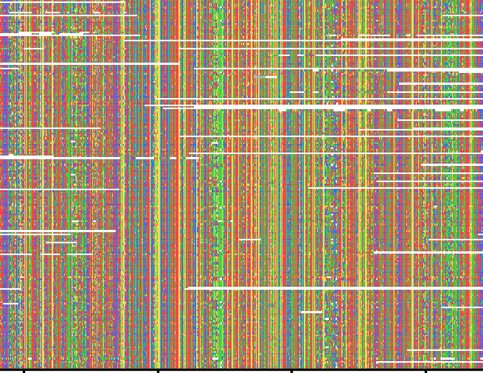
Phylogenetic Analysis
NST Part IA Mathematical Biology
May 2 2024
Dr Katy Brown
Firth Lab, Virology Division, Department of Pathology
kab84@cam.ac.uk

Slide 2
Practical
Hicks Room, University Centre
Assessed practical will be distributed afterwards

Slide 3
Lecture Plan
Introduction to Phylogenetics
What is a phylogenetic tree?
Reading a phylogenetic tree
Building a phylogenetic tree:
Distance methods
Maximum parsimony
Maximum likelihood
Bayesian methods

Slide 4
What is a phylogenetic tree?

Slide 5
Phylogenetics (1)
Phylogenetics is the study of evolutionary relationships among or within groups of organisms
Making phylogenetic inferences is one of the applications of multiple sequence alignment.
Can also be based on other traits e.g. morphology
Results used to create a phylogenetic tree

Slide 6
Phylogenetics (2)
A phylogenetic tree is a hypothesis
The relationships shown are not definitive, they are the best estimate based on the data and the methodology.

Slide 7
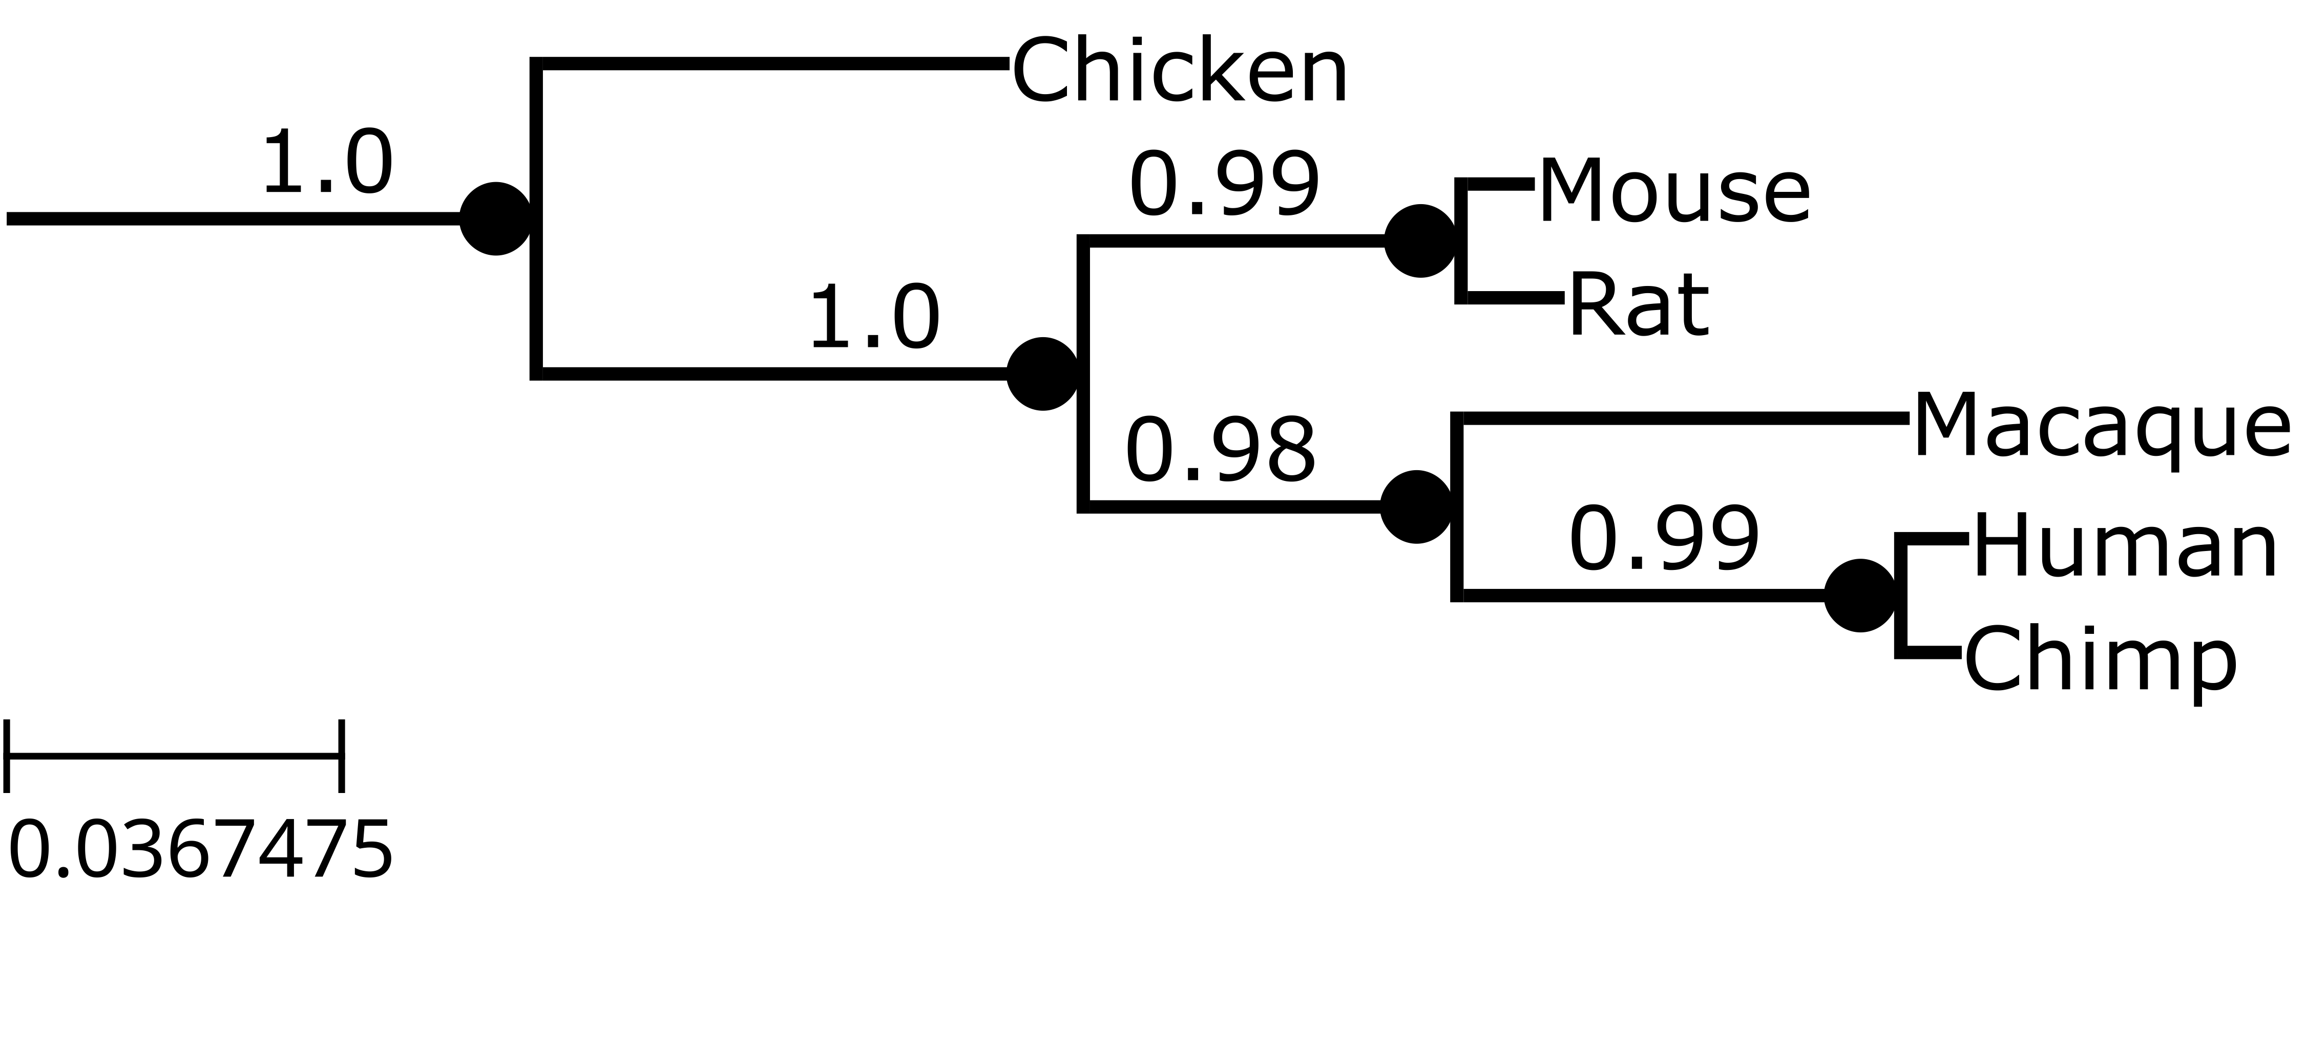
Phylogenetic Trees (1)
The outcome of a phylogenetic analysis is a phylogenetic tree
Each branching event shows divergence from a common ancestor
more recent

Slide 8
Phylogenetic Trees (2)
The outcome of a phylogenetic analysis is a phylogenetic tree
Evolution of traits unique to chicken
Evolution of traits unique to mouse
Evolution of traits shared by all species
Evolution of traits shared by mouse, rat
Evolution of traits shared by mouse, rat, macaque, human, chimp
Evolution of traits shared by macaque, human, chimp

Slide 9
Reading a Phylogenetic Tree

Slide 10
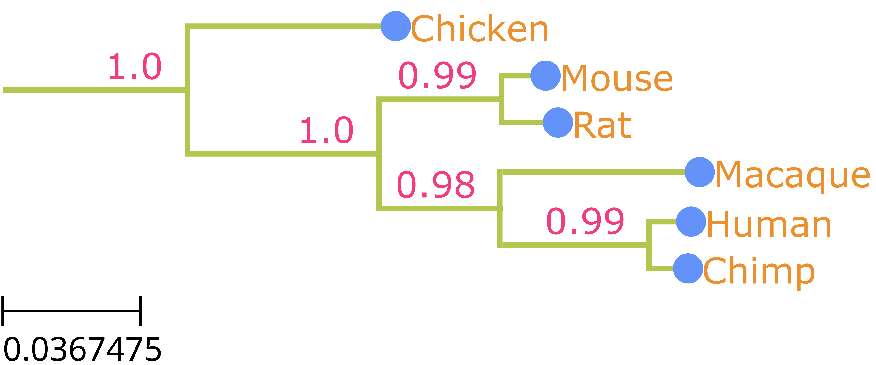

Terminology
Root
Branches
Branch Support
Leaf / tip labels
Nodes
Leaves (aka tips / terminal nodes)
branches
leaves
root

Slide 11
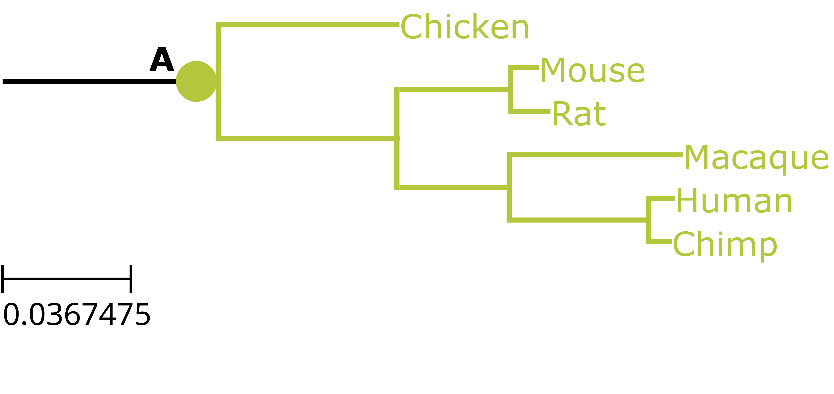
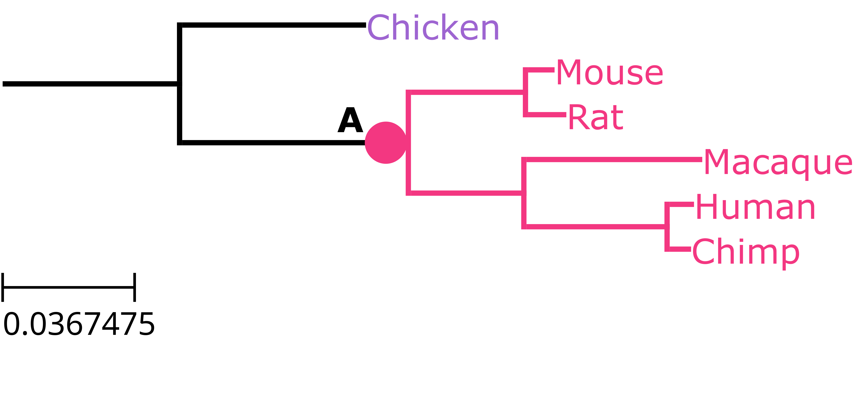
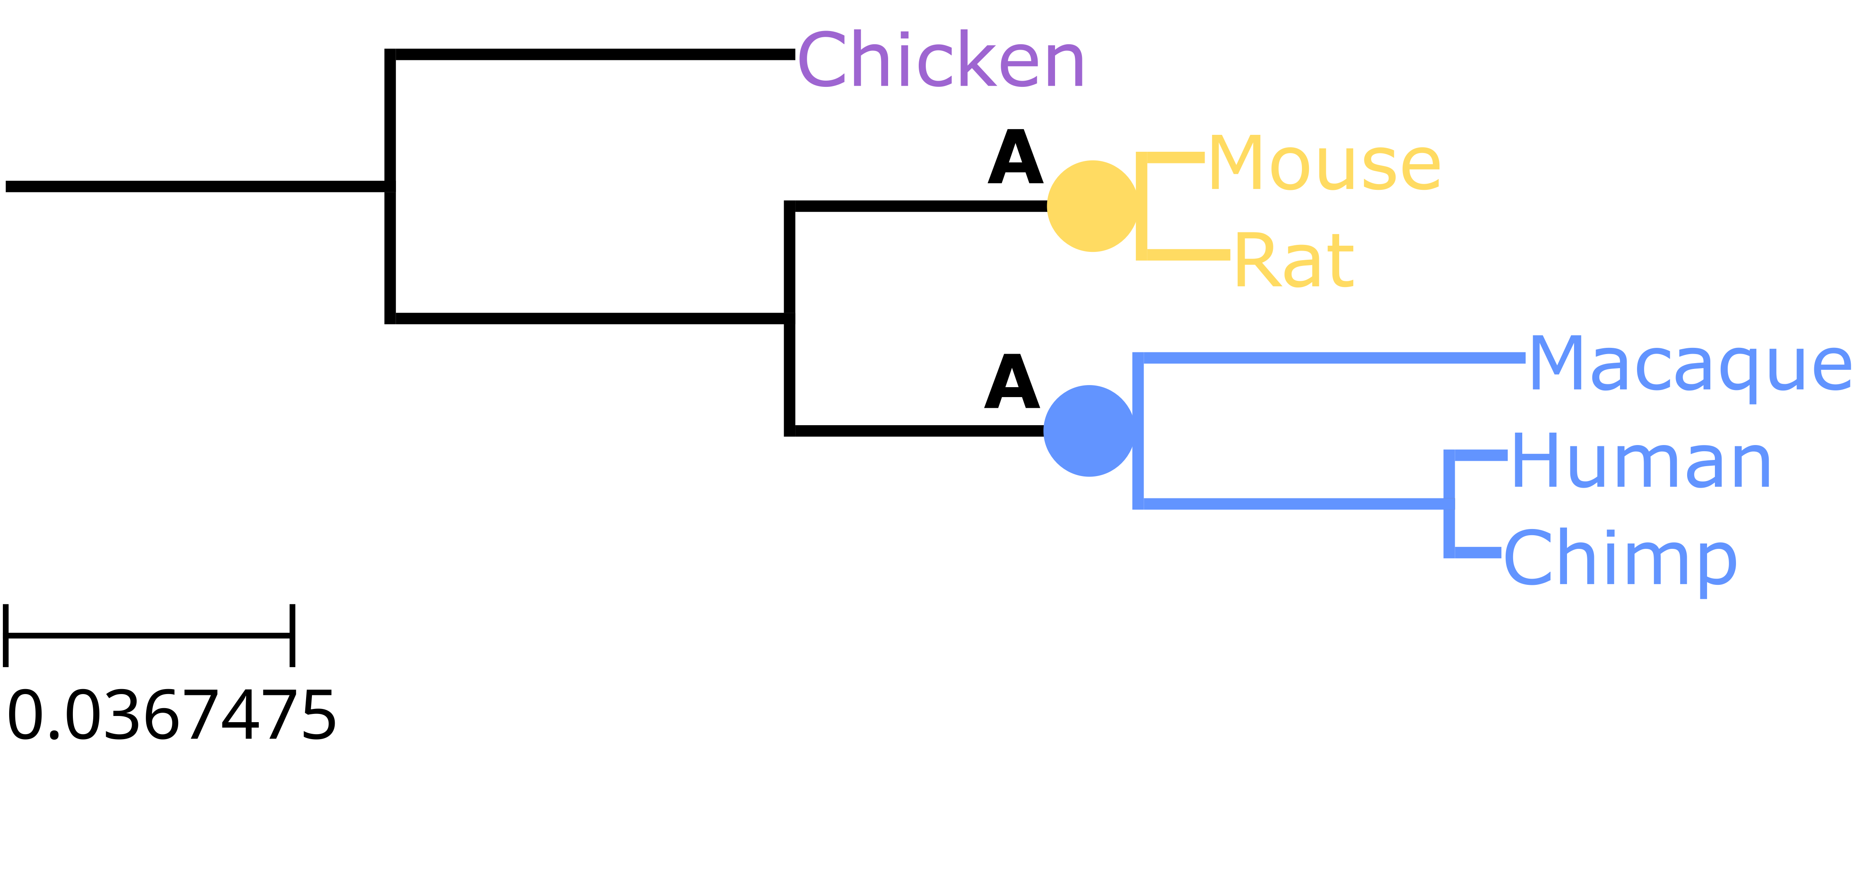
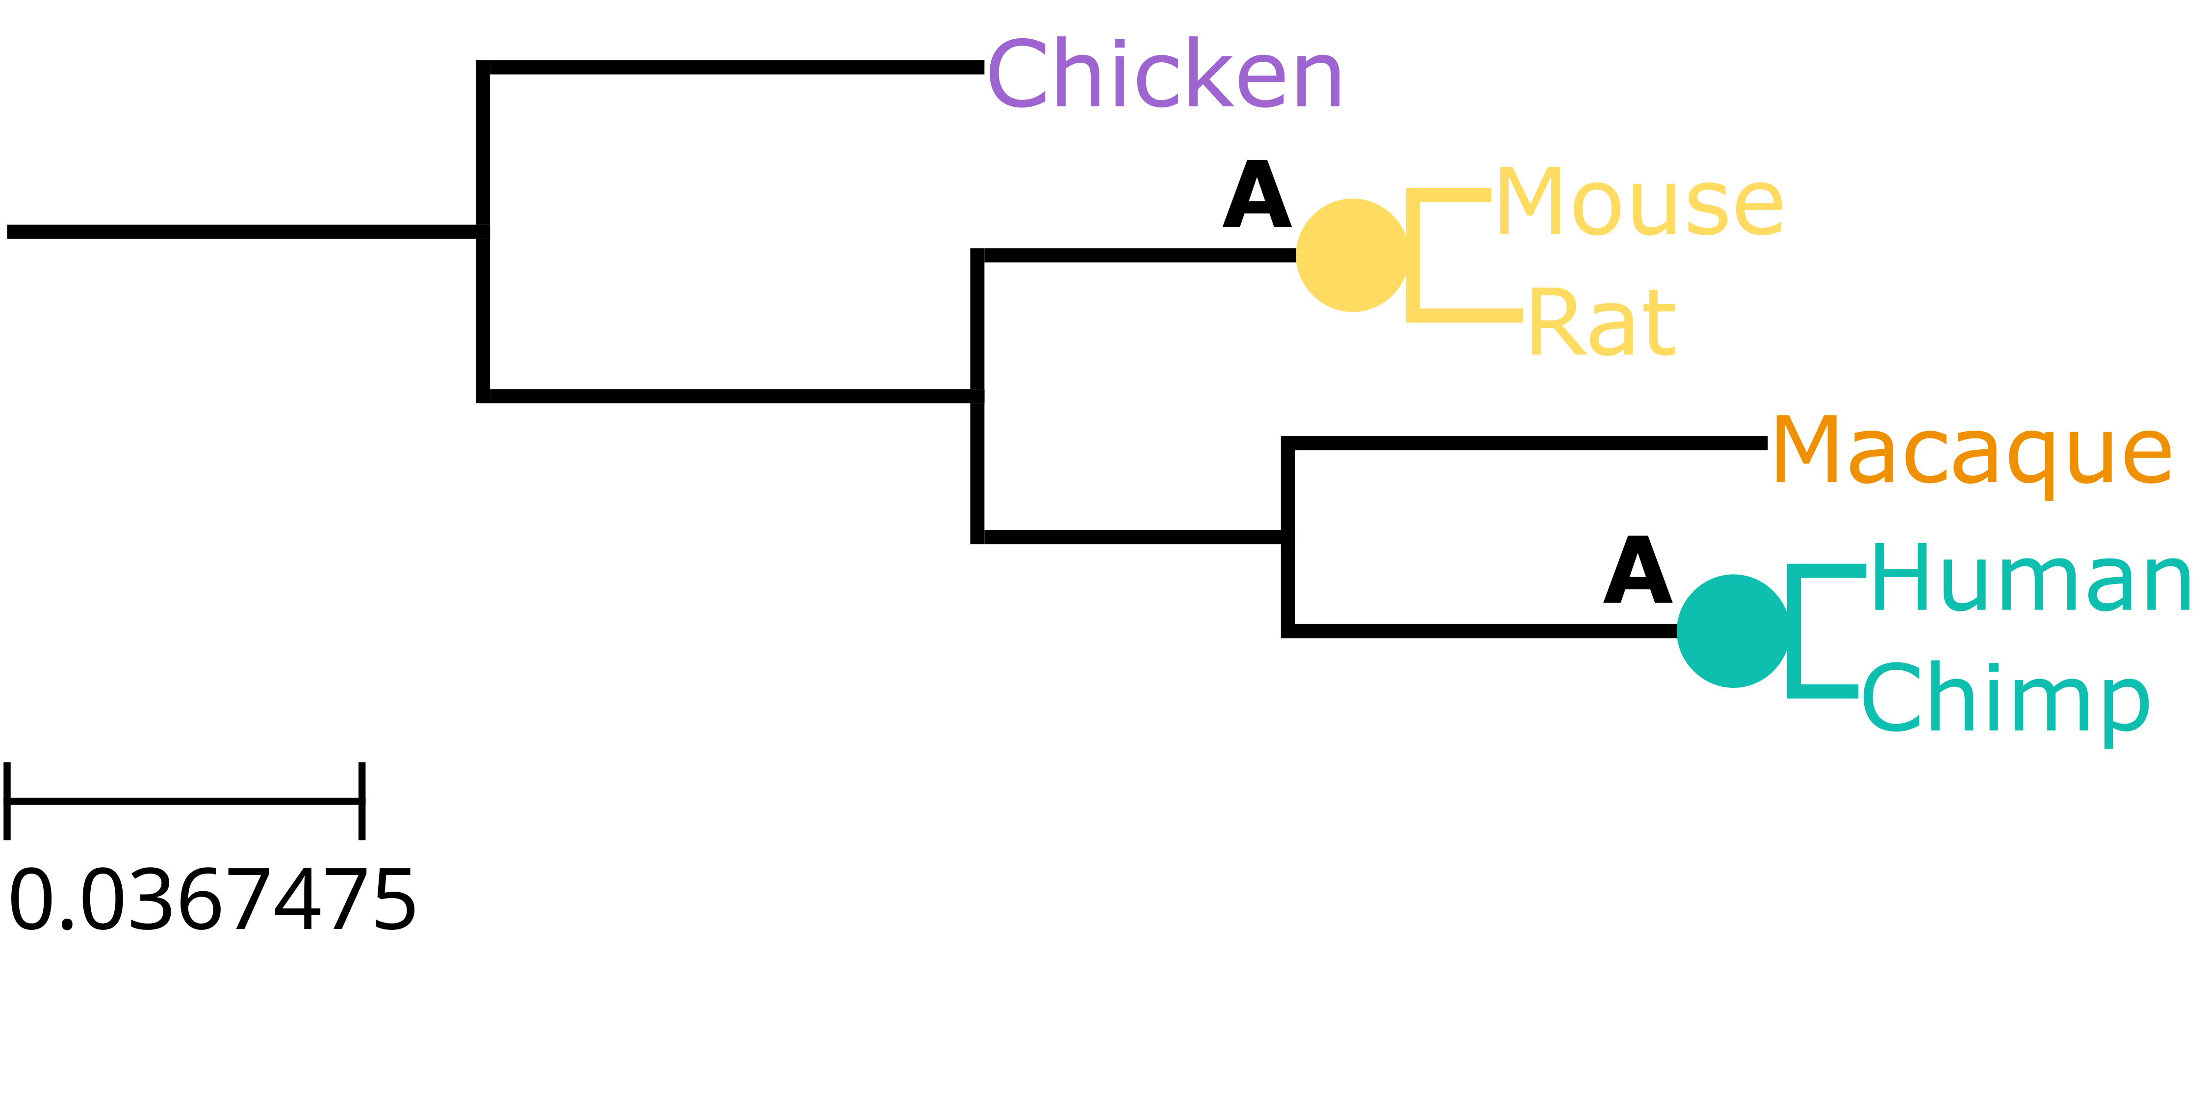
Ancestors and Descendants
All of the descendants of a common ancestor are shown on the tips of the branches of the tree

Slide 12
Clades (1)
A clade is a group containing a common ancestor and all of its descendants
A clade can also be called a monophyletic group or a monophyletic clade
Clade
Clade
Clade
Clade
Clade
Clade

Slide 13
Clades (2)
If a group does not contain all the descendants of a common ancestor, it is not a clade
Only within the dataset – there can be other descendants which are not included.
Not a clade
Not a clade

Slide 14
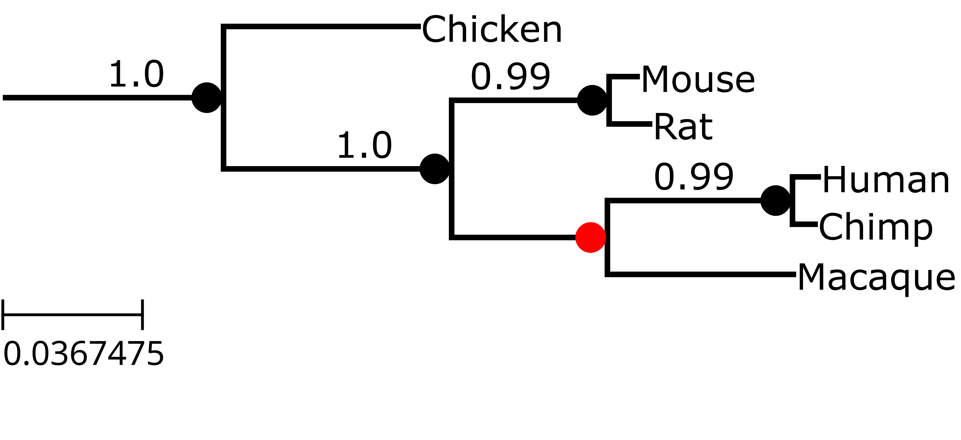
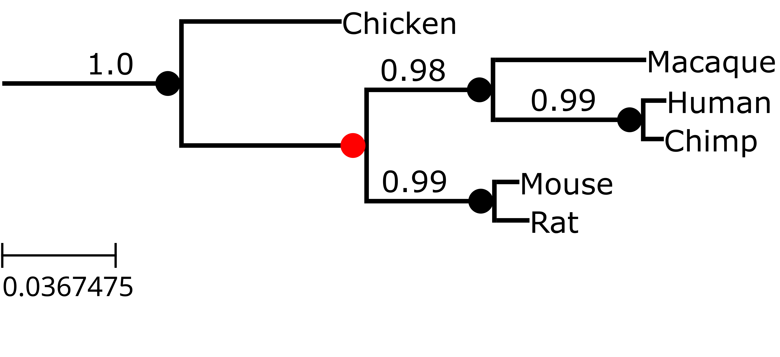
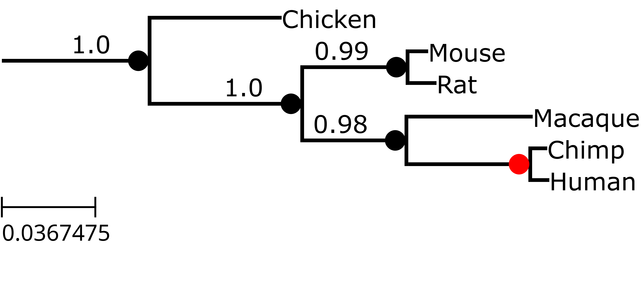
Topology (1)
Each node can be rotated and the relationships in the tree do not change
=
=
=
=
=

Slide 15
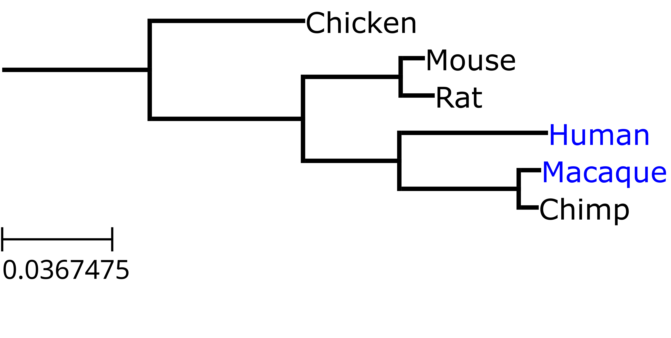
Topology (2)
Trees with a different branching order are not the same
≠

Slide 16
Rooting
A rooted phylogenetic tree implies that branching events which are closer to the tips are more recent.
Ideally, you should only use this type of tree if you know which event happened first.
root
more recent

Slide 17
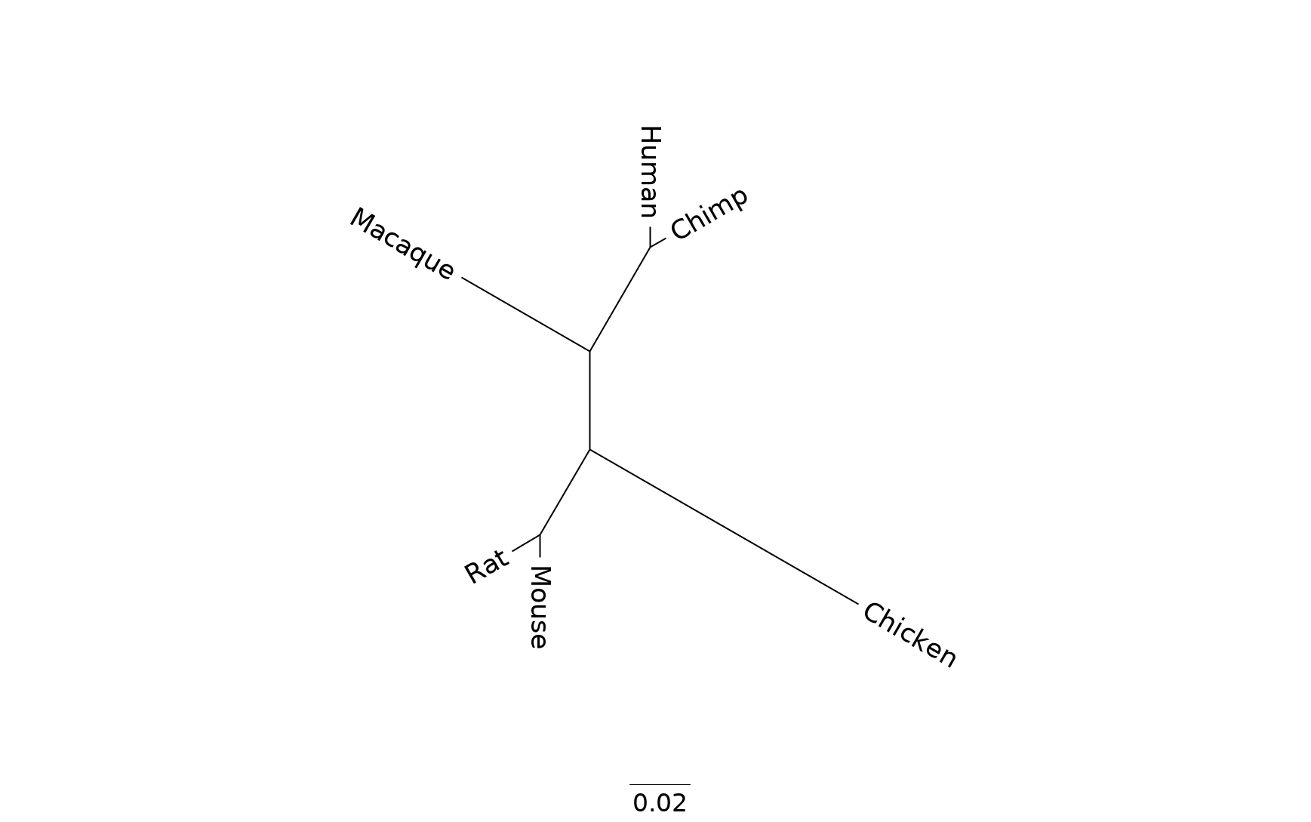
Unrooted Tree
An unrooted tree doesn’t have an implied order of events

Slide 18
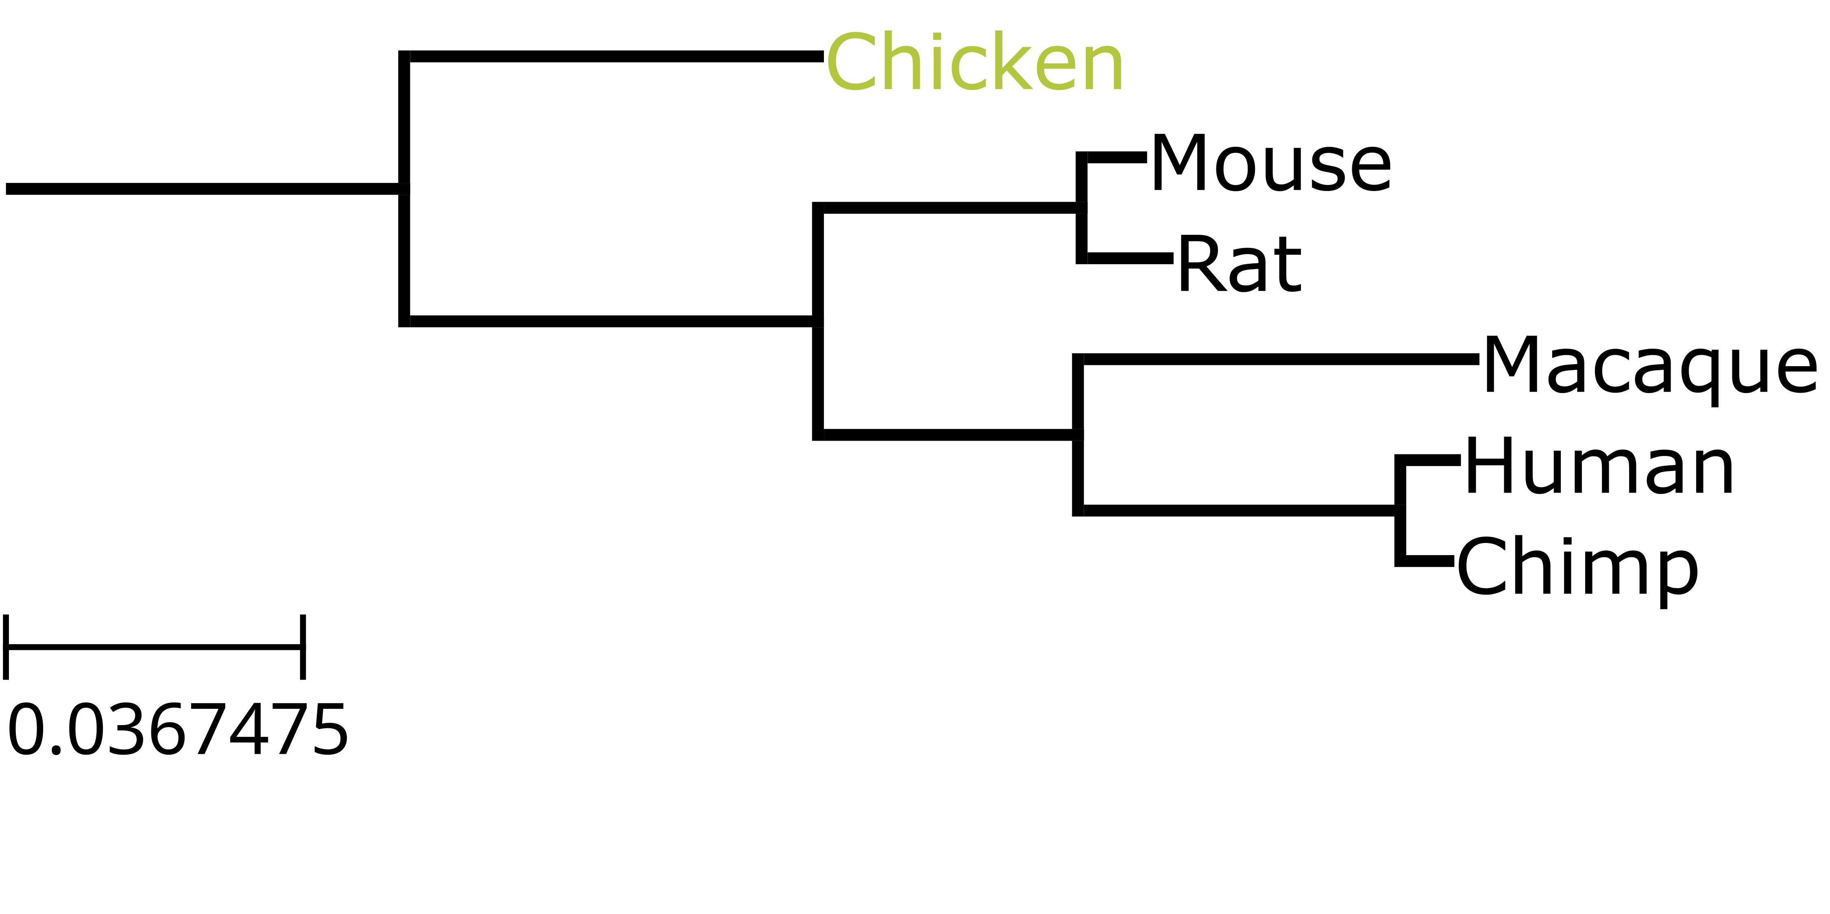
Setting an Outgroup (1)
It’s common to include one sequence you know is more distant than the others and make this the root.

Slide 19
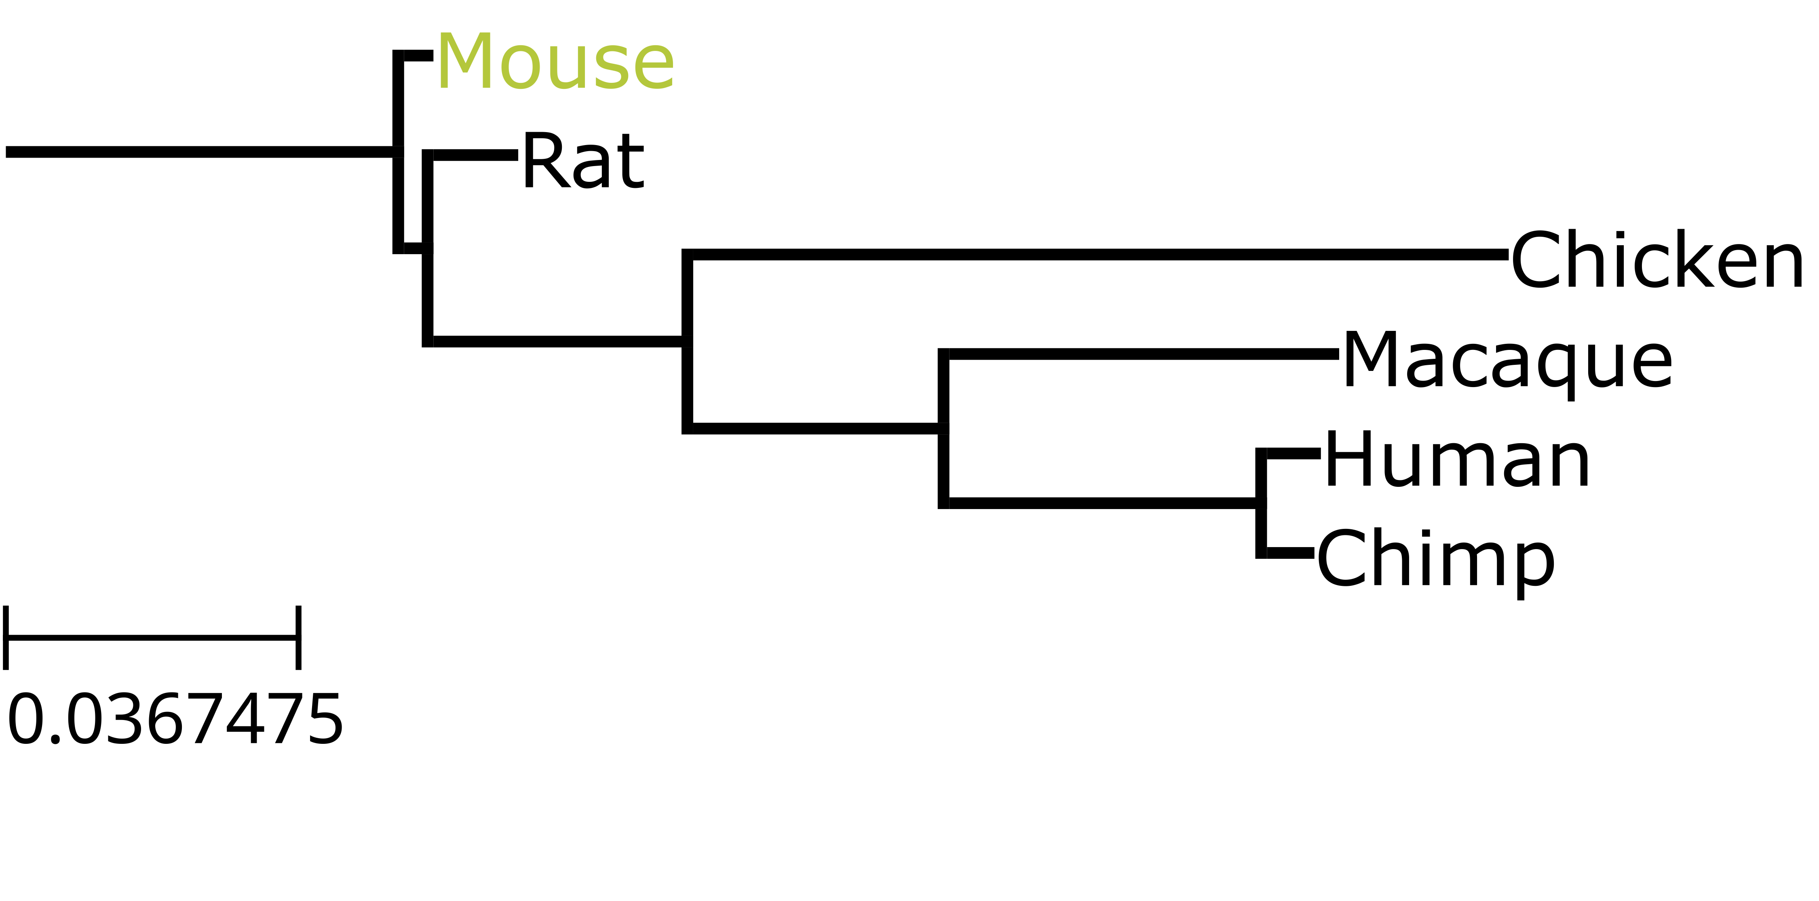
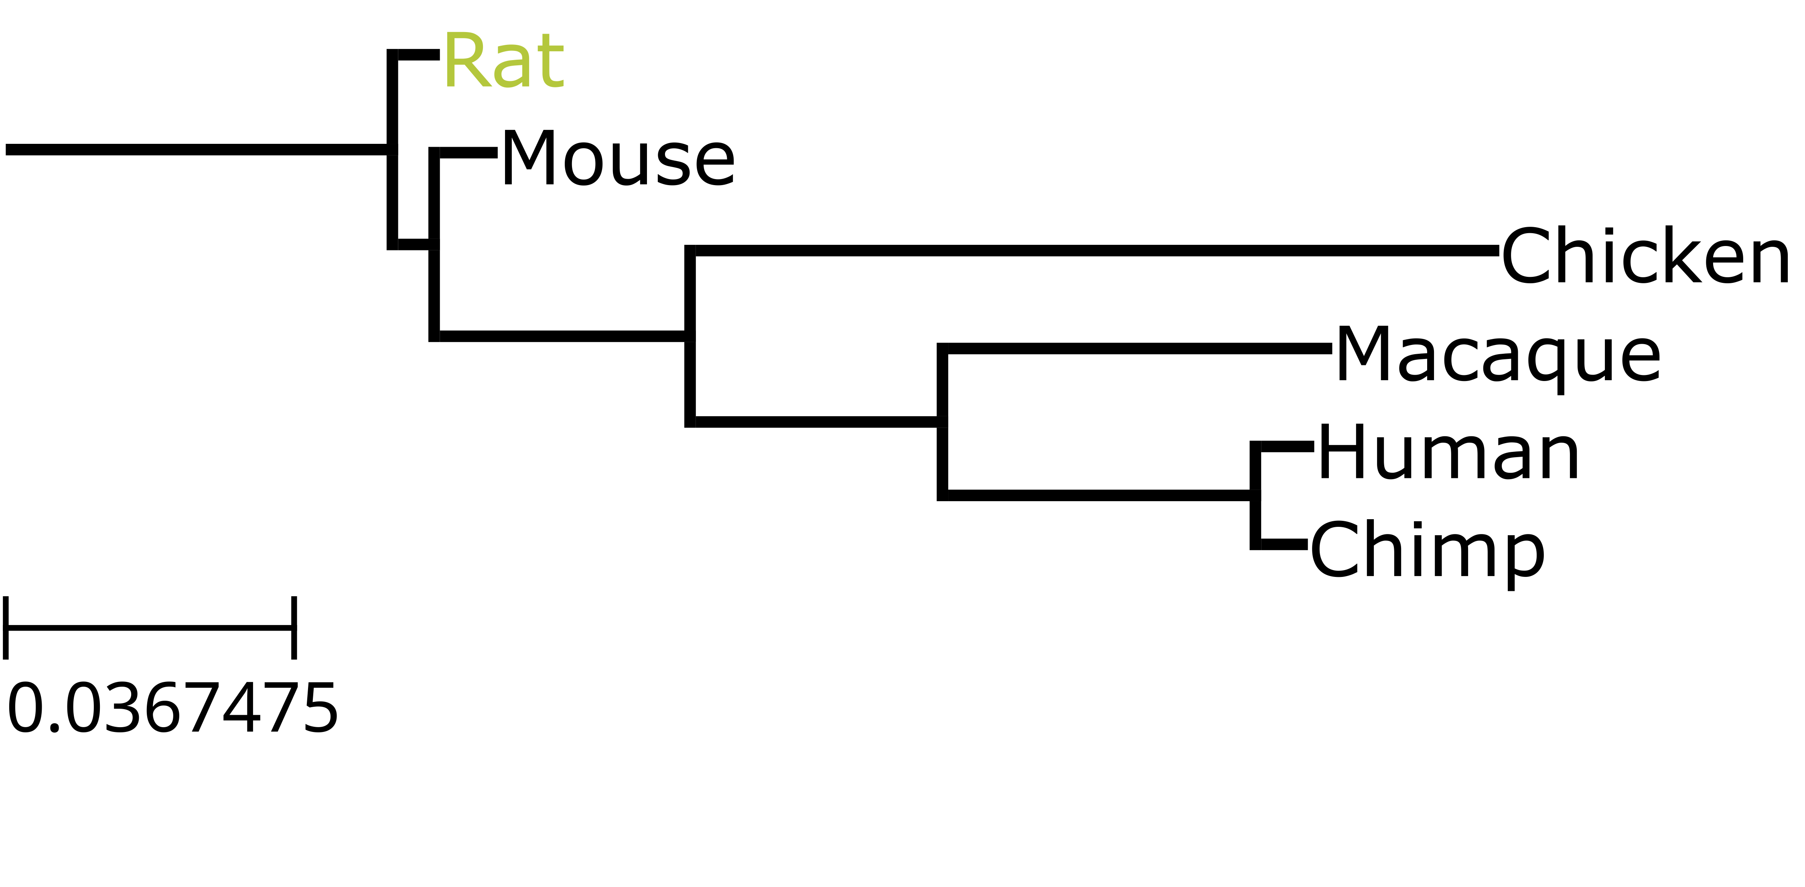
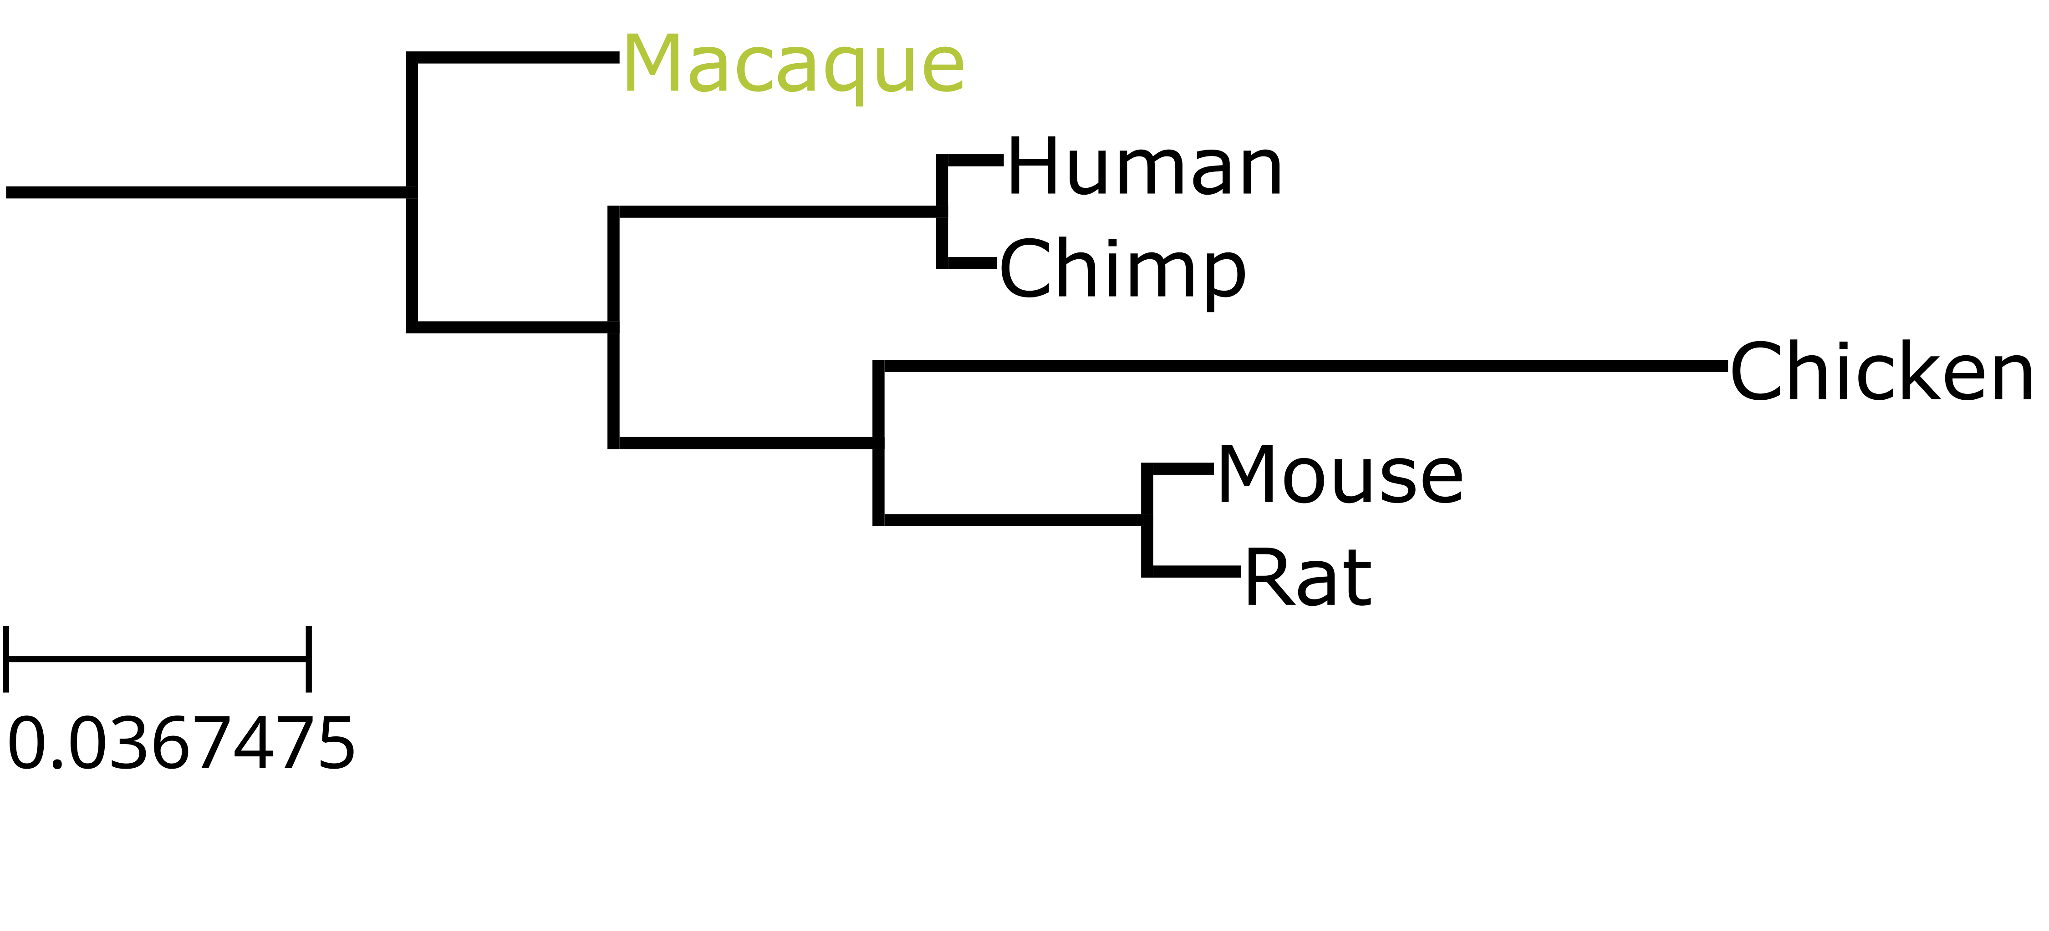
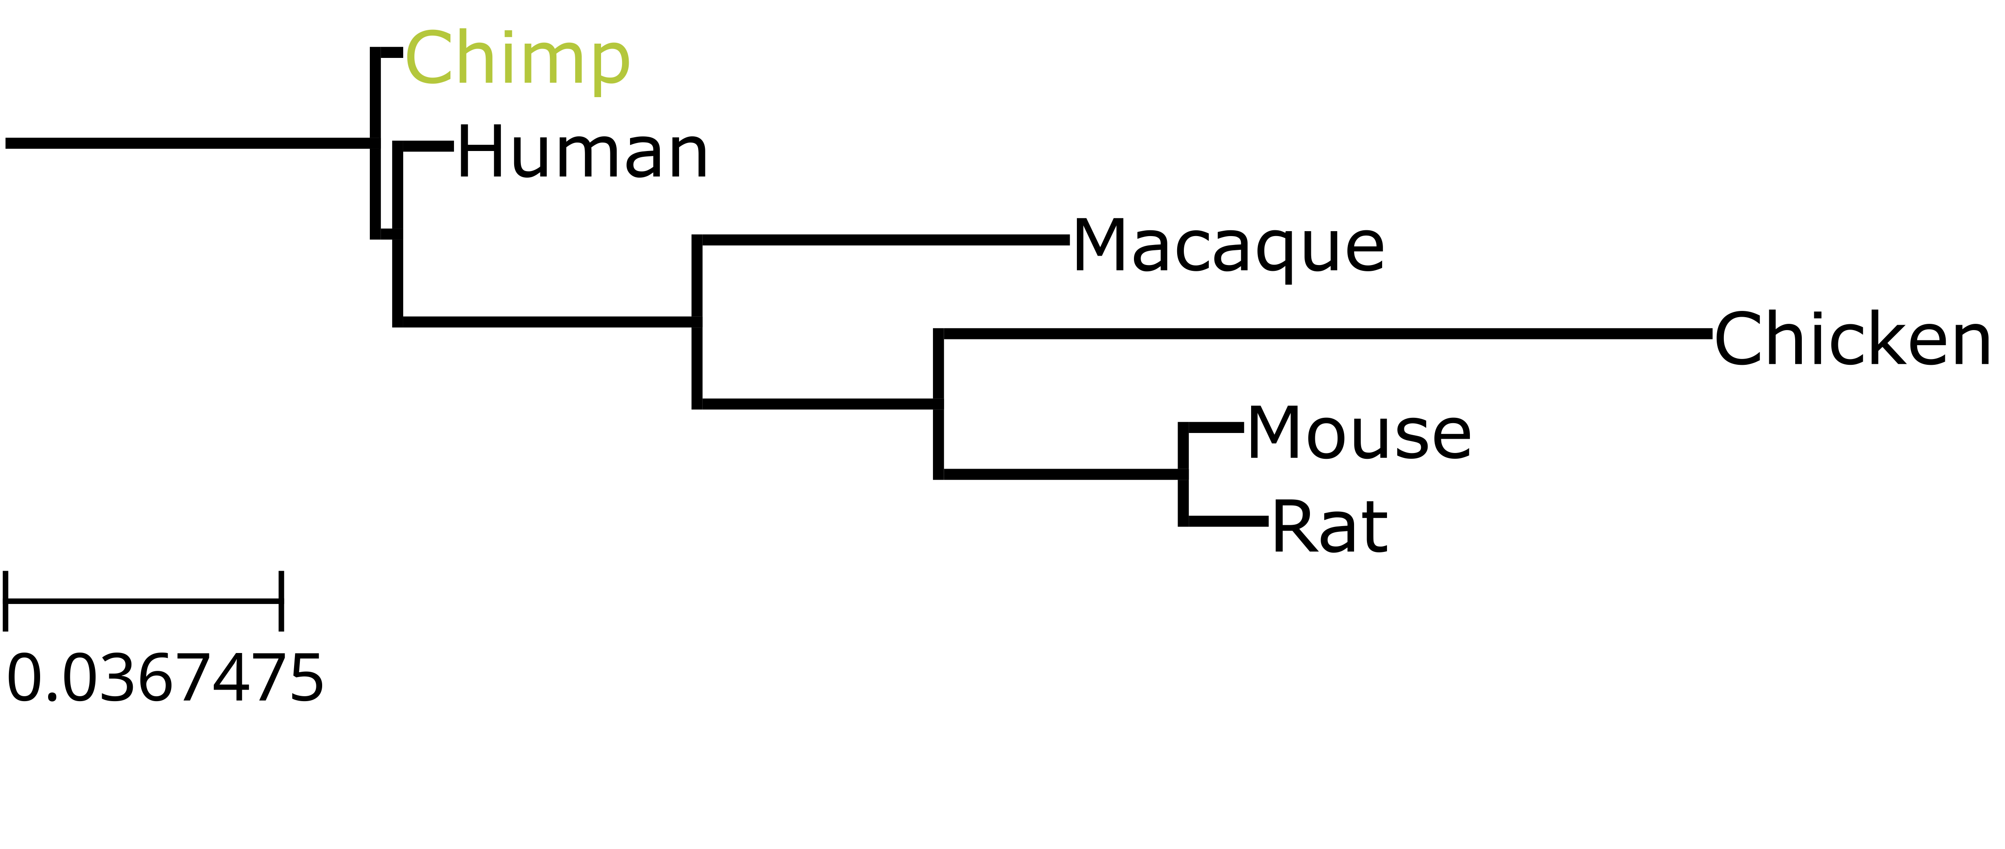

Setting an Outgroup (2)
You can set any sequence as the outgroup (but you usually shouldn’t).

Slide 20
Branch Lengths
The length of each branch corresponds to the amount of genetic change which has occurred
Longer branches = more change
There should be a scale bar indicating how much change corresponds to a specific branch length, the unit is usually substitutions per site

Slide 21
Branch Support
99% confidence that given this data, within this dataset, human and chimp cluster together, excluding any other sequences
Phylogenies are uncertain and branch support values show the degree of uncertainty.
The value refers to the confidence that the sequences to the right of the node cluster together with the exclusion of any other
100% confidence that given this data, within this dataset, the mammal species cluster together, excluding any other sequences
There are various methods to estimate branch support.
One common method is called “bootstrapping”:
Repeatedly take samples of the columns of the alignment and rebuild the tree using these columns
Calculate the proportion of rebuilt trees that contain this cluster.

Slide 22
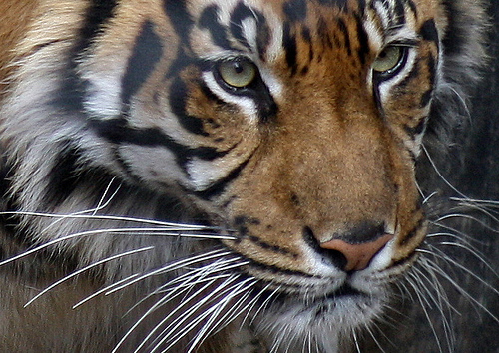
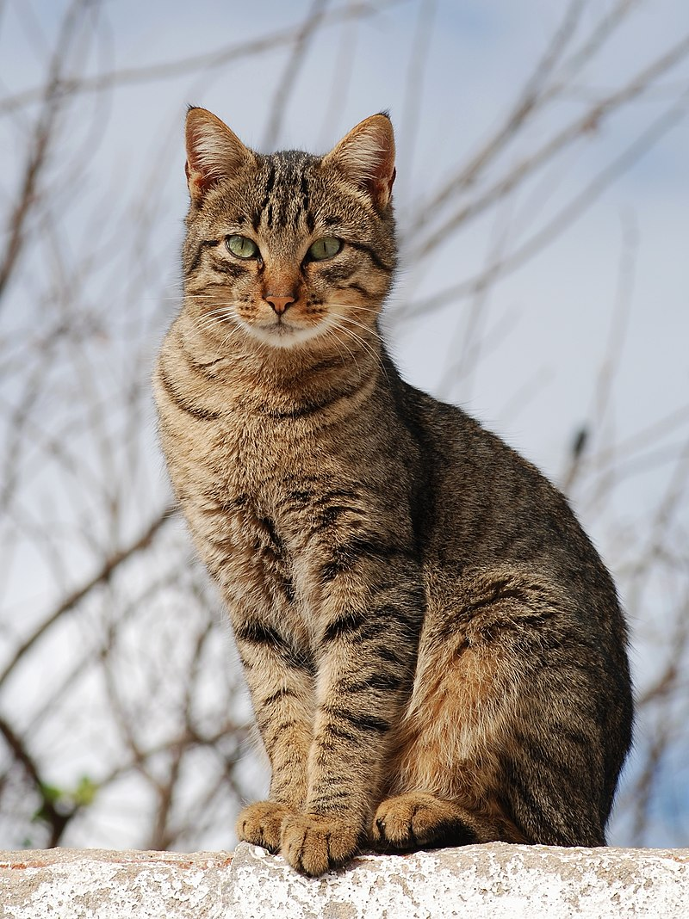
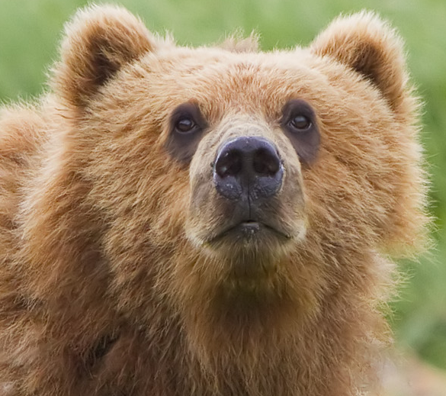
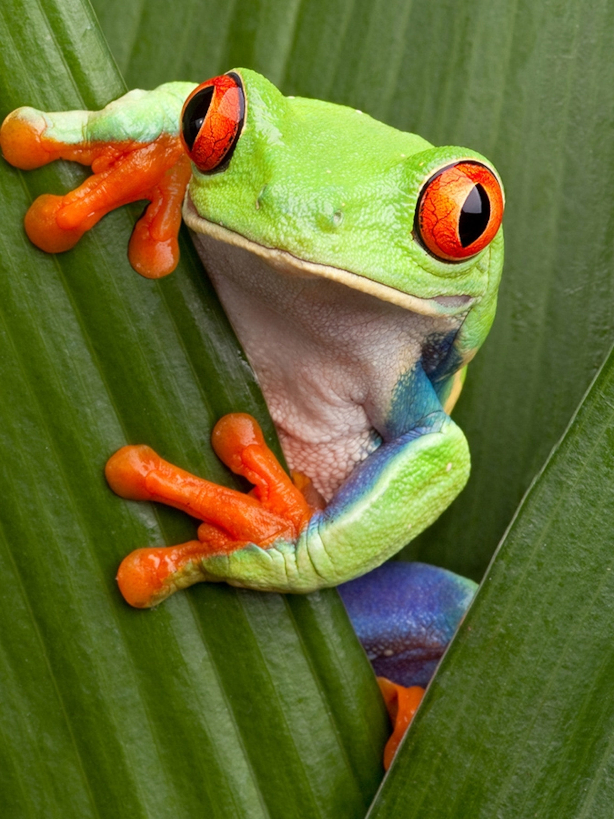
Phylogenetics Using Morphology (1)
Tiger
whiskers
whiskers
fluff
Cat
fluffy
four legs
Bear
4 legs
group species with shared traits
Frog

Slide 23
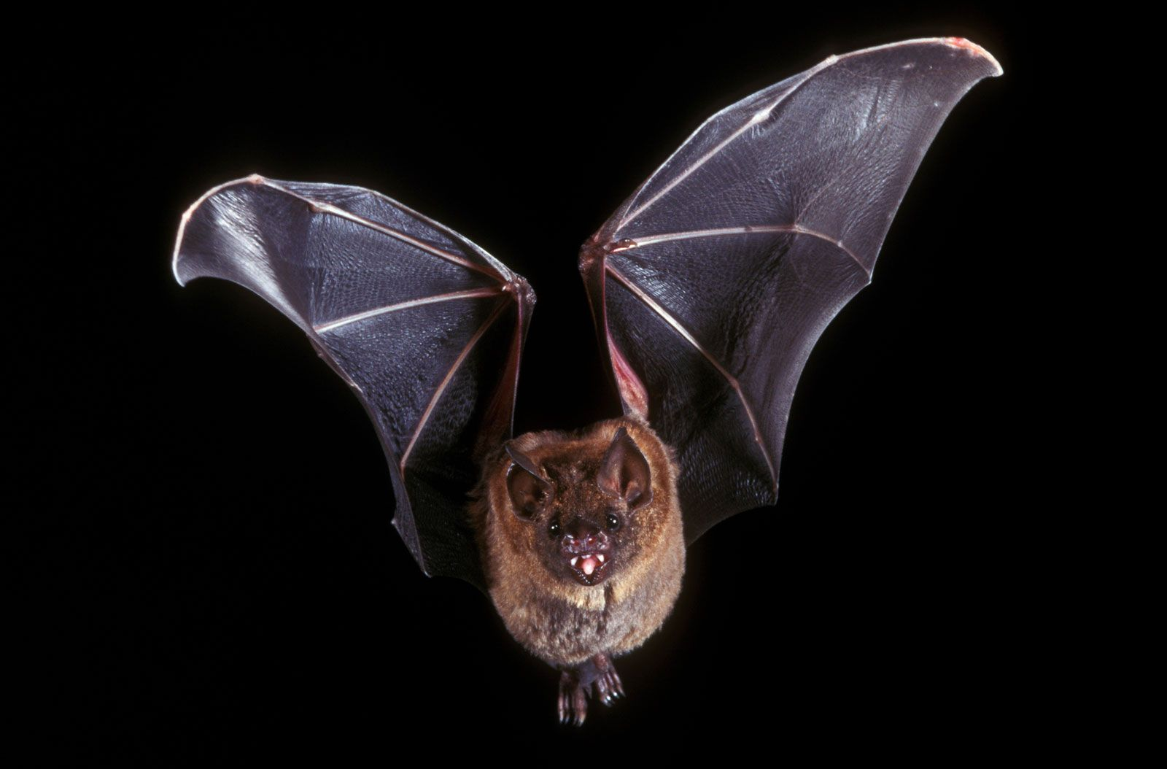
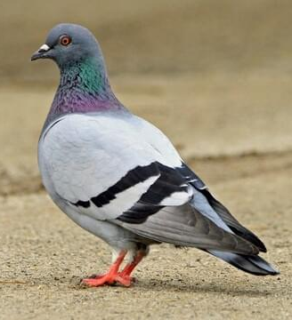
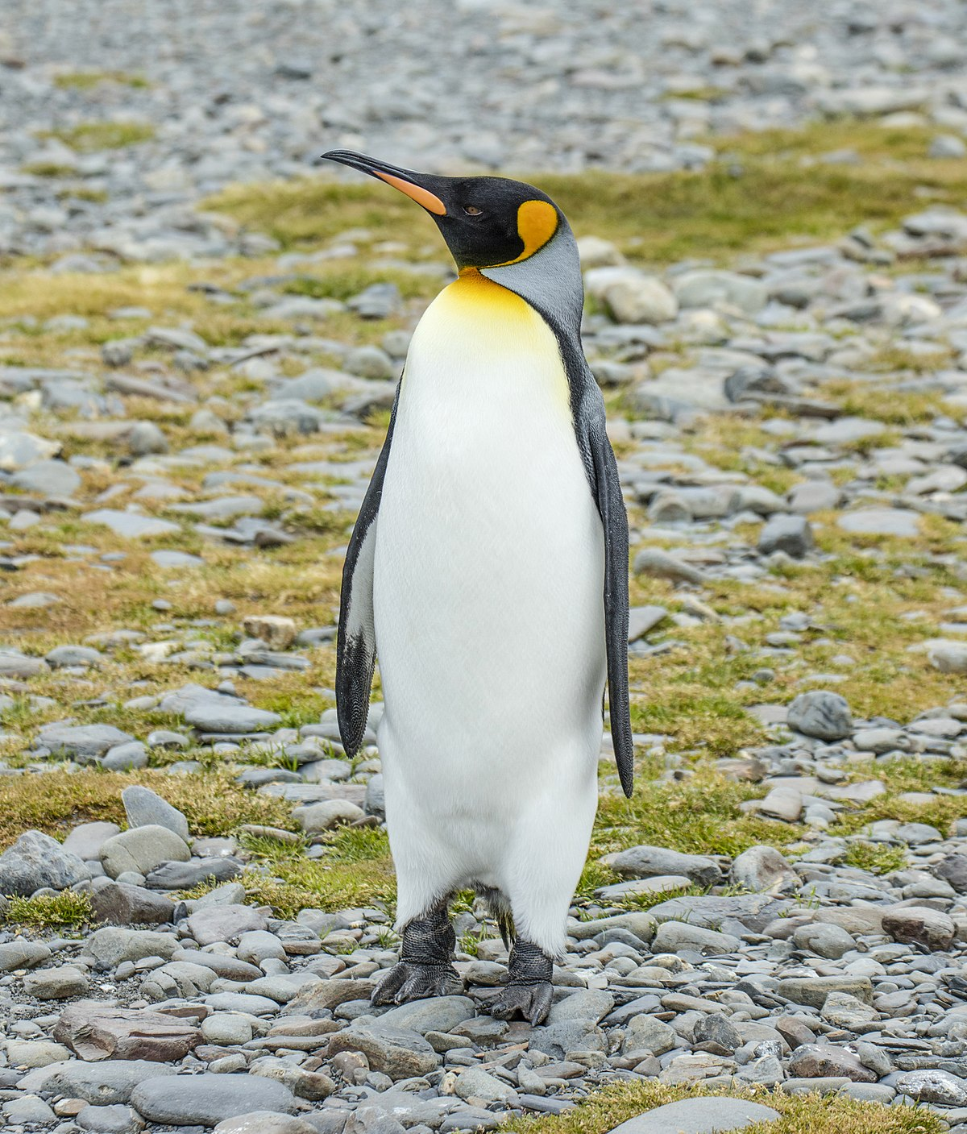
Phylogenetics Using Morphology (2)
Can differ from our hypothesis based on molecular data.
Convergent evolution – the same trait evolving more than once
The same trait can also be lost more than once
bat
can fly
pigeon
penguin
can’t fly
cat

Slide 24
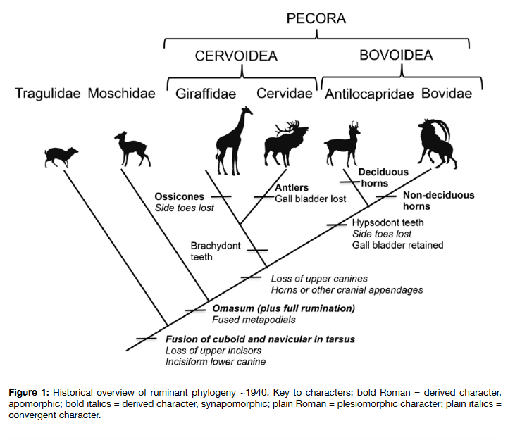
Phylogenetics Using Morphology
Janis & Theodor, 2014
Overview of ruminant phylogenetics through time
1940 phylogeny based on morphological data
Janis, C. M. & Theodor, J. M. Cranial and postcranial morphological data in ruminant phylogenetics, Zitteliana, 32:15-31. doi:10.5282/ubm/epub.22383

Slide 25
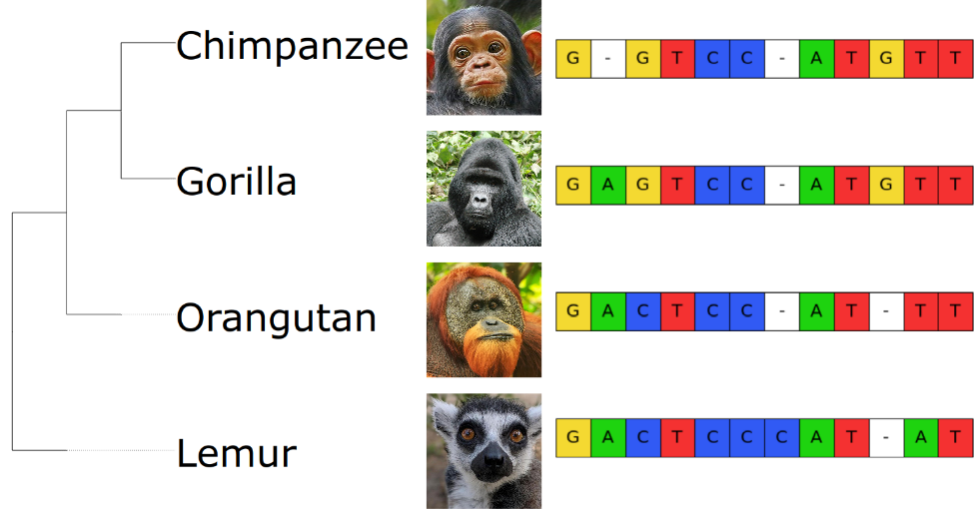
Phylogenetics Using Sequences
Phylogenetic trees can be based on nucleotide or amino acid alignments – the sequences are the traits
By aligning sequences we can hypothesise about how they evolved

Slide 26
Building a Phylogenetic Tree

Slide 27
Building a Tree
Sequence based phylogenetic trees are generally built based on multiple sequence alignments
Different methods are used to estimate the evolutionary distance between sequences in the alignment

Slide 28
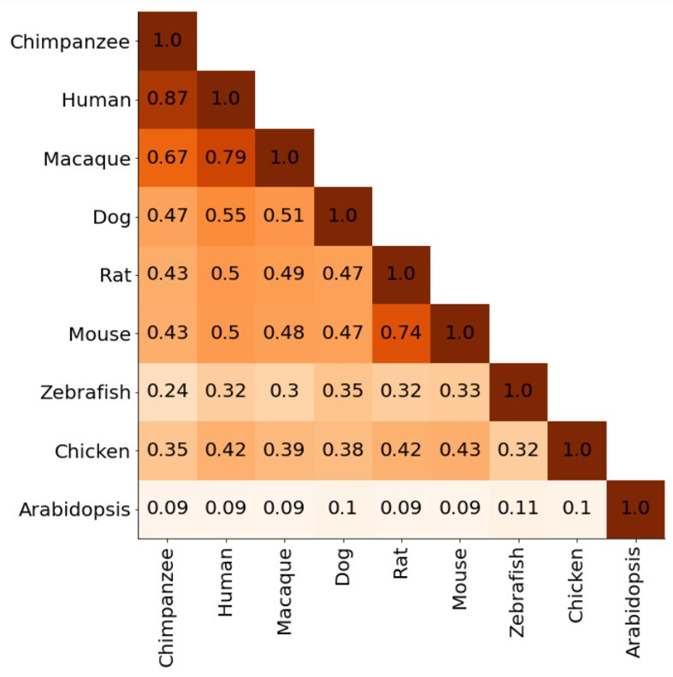
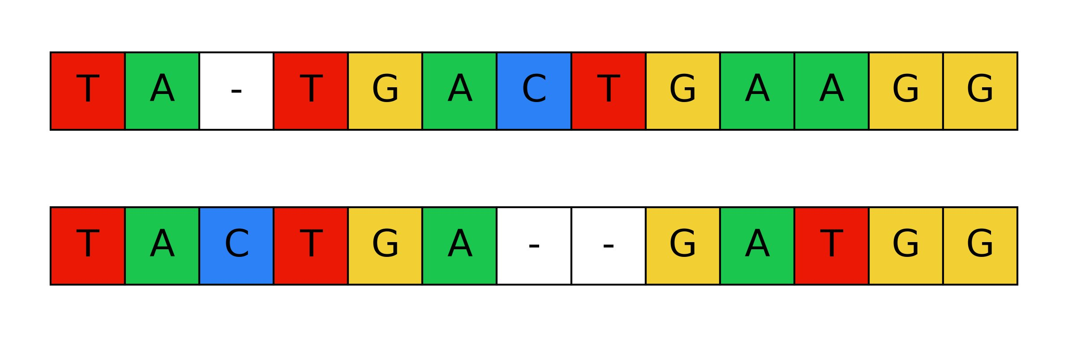
Distance Based Methods
Based on the pairwise distance between sequences
This distance can be calculated in various ways
Simplest – number of differences between sequences

Slide 29
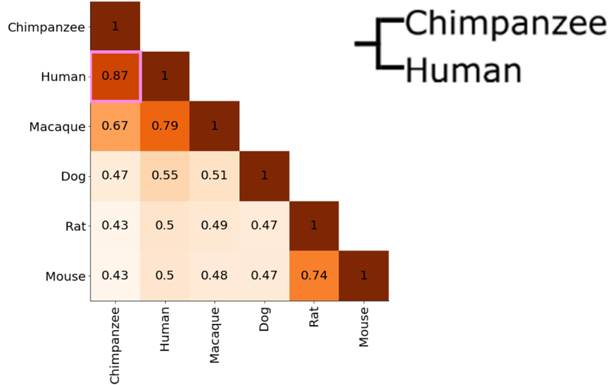
UPGMA Clustering (1) Unweighted Pair Group with Arithmetic Mean
One of the simplest approaches to clustering
Start with a similarity matrix for a group of species
Higher number = more similar

Slide 30
UPGMA Clustering (2)
Take the most similar sequences in the matrix – the highest scoring pair
0.87, chimpanzee vs human.
These sequences form the first cluster.

Slide 31
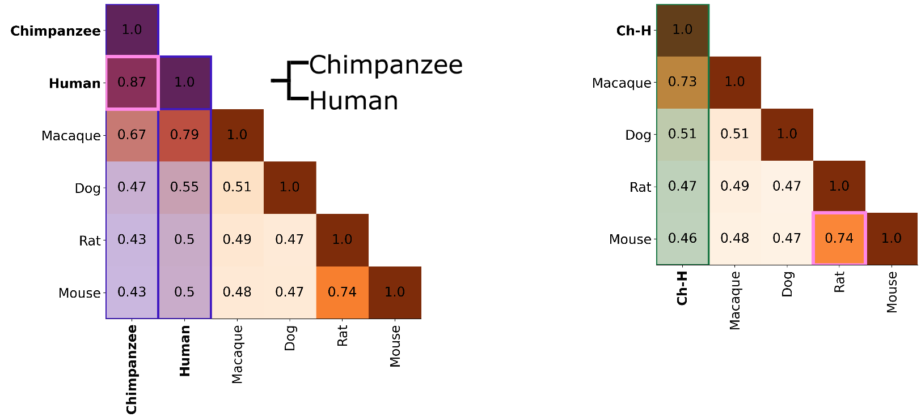
UPGMA Clustering (3)
Make a new “Chimpanzee-Human” (Ch-H) column with the mean similarity between each sequence and these two sequences
e.g.
macaque vs human = 0.79
macaque vs chimpanzee = 0.67
macaque vs chimpanzee-human = (0.79 + 0.67) / 2 = 0.73

Slide 32
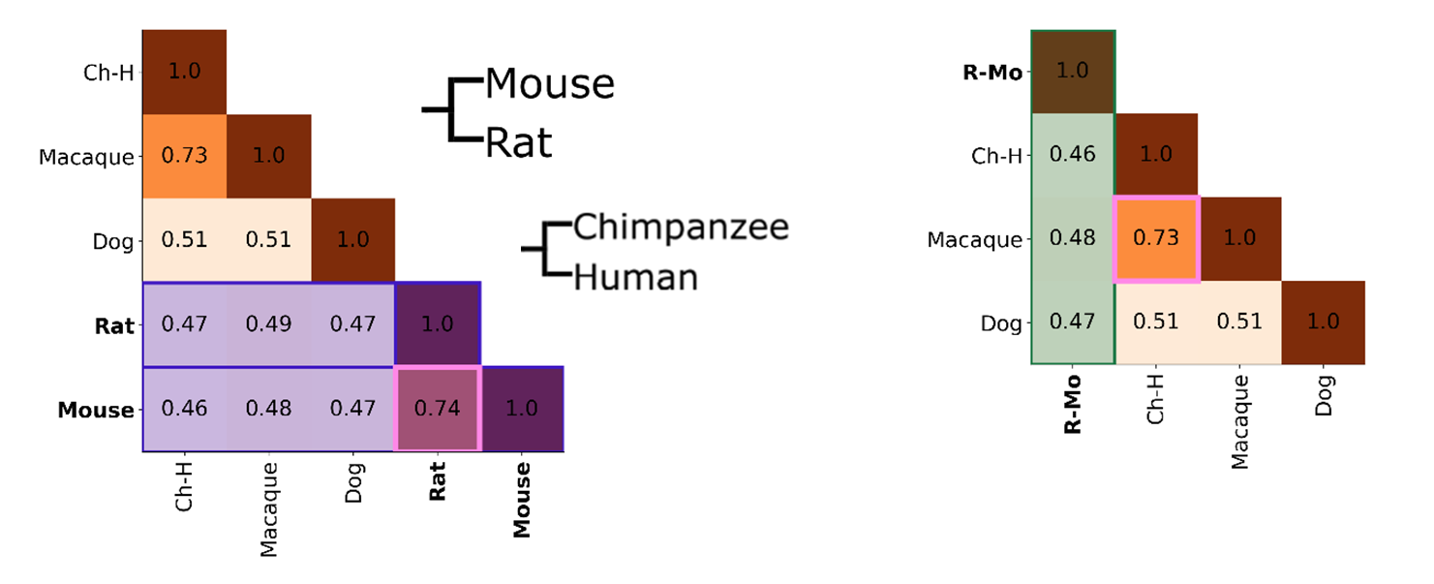
UPGMA Clustering (4)
Repeat with the next nearest sequences – rat and mouse
Now we can cluster mouse and rat together as well as chimp and human

Slide 33
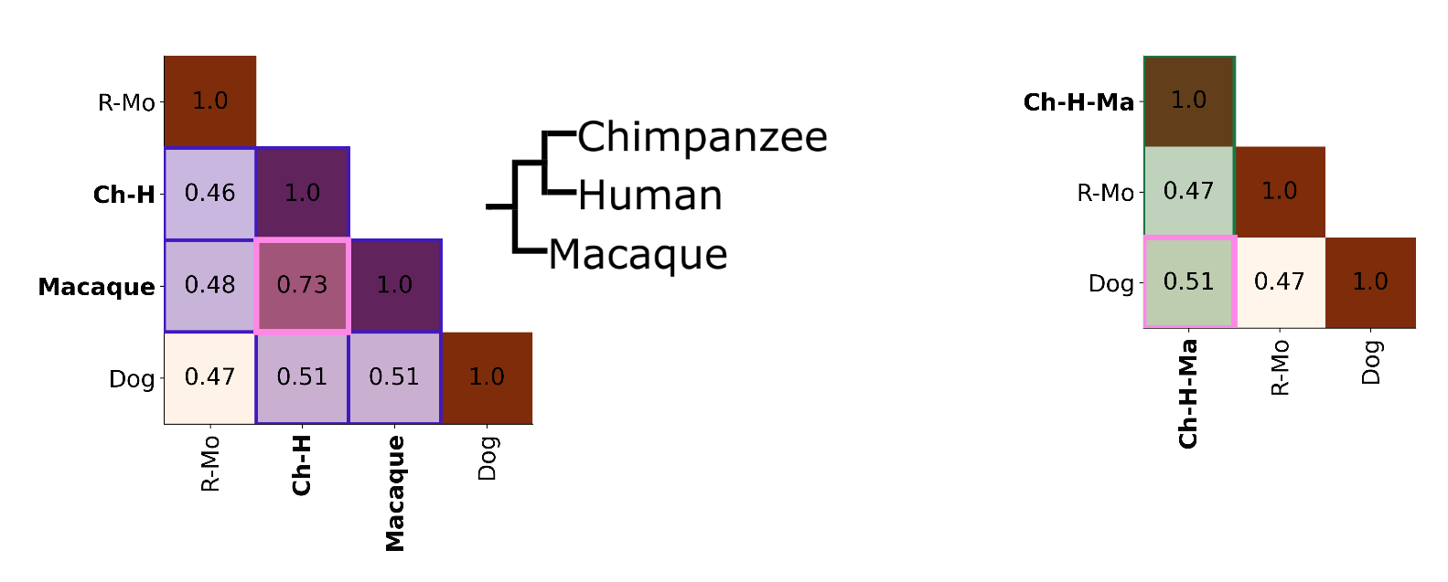
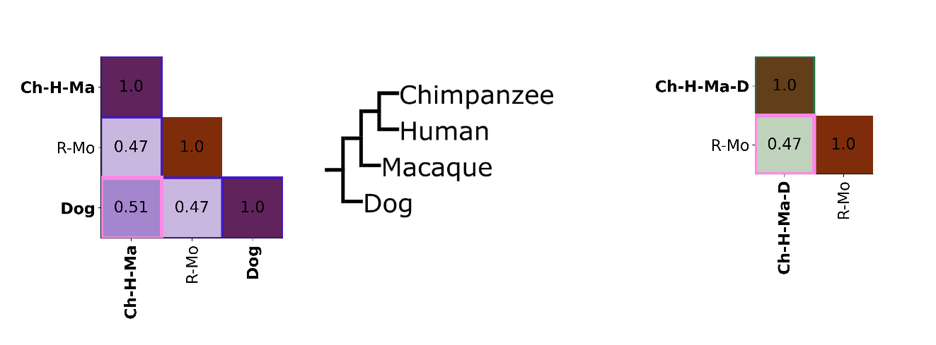
UPGMA Clustering (5)

Slide 34
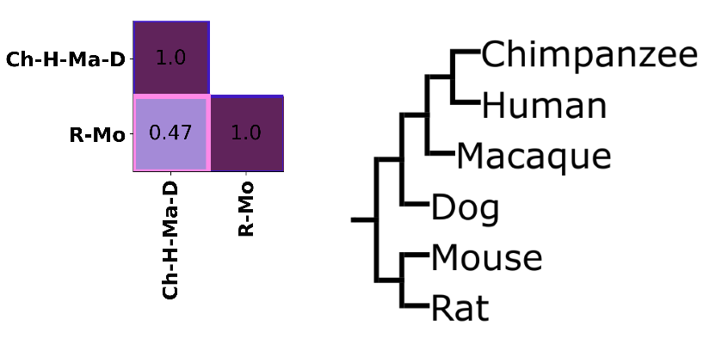
UPGMA Clustering (6)
This gives us our phylogenetic tree

Slide 35
UPGMA Clustering (7)
UPGMA assumes:
The mean rate of substitutions is constant over time
Branch lengths correspond to time
Branches are symmetrical

Slide 36
UPGMA Clustering (8)
In reality:
Sequences are subject to natural selection (few substitutions are neutral)
Different species have different generation times (e.g. human vs mouse)
There can be multiple substitutions at the same site

Slide 37
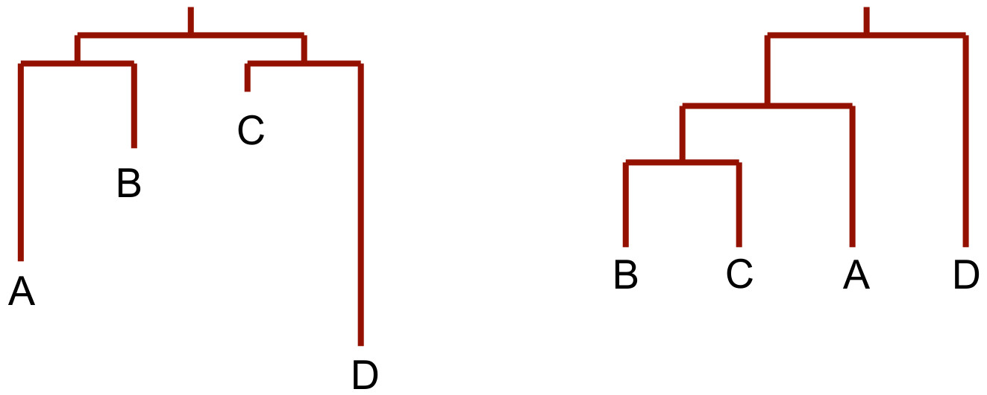
UPGMA Clustering (9)
Real tree UPGMA approximation

Slide 38
Neighbour Joining (1)
Clustering can also be performed using the Neighbour-Joining tree algorithm (Saitou & Nei, 1987)
Works on the principle that branch lengths are additive
i.e. the distance between any pair of leaves is the sum of the lengths of the edges on the path connecting them

Slide 39
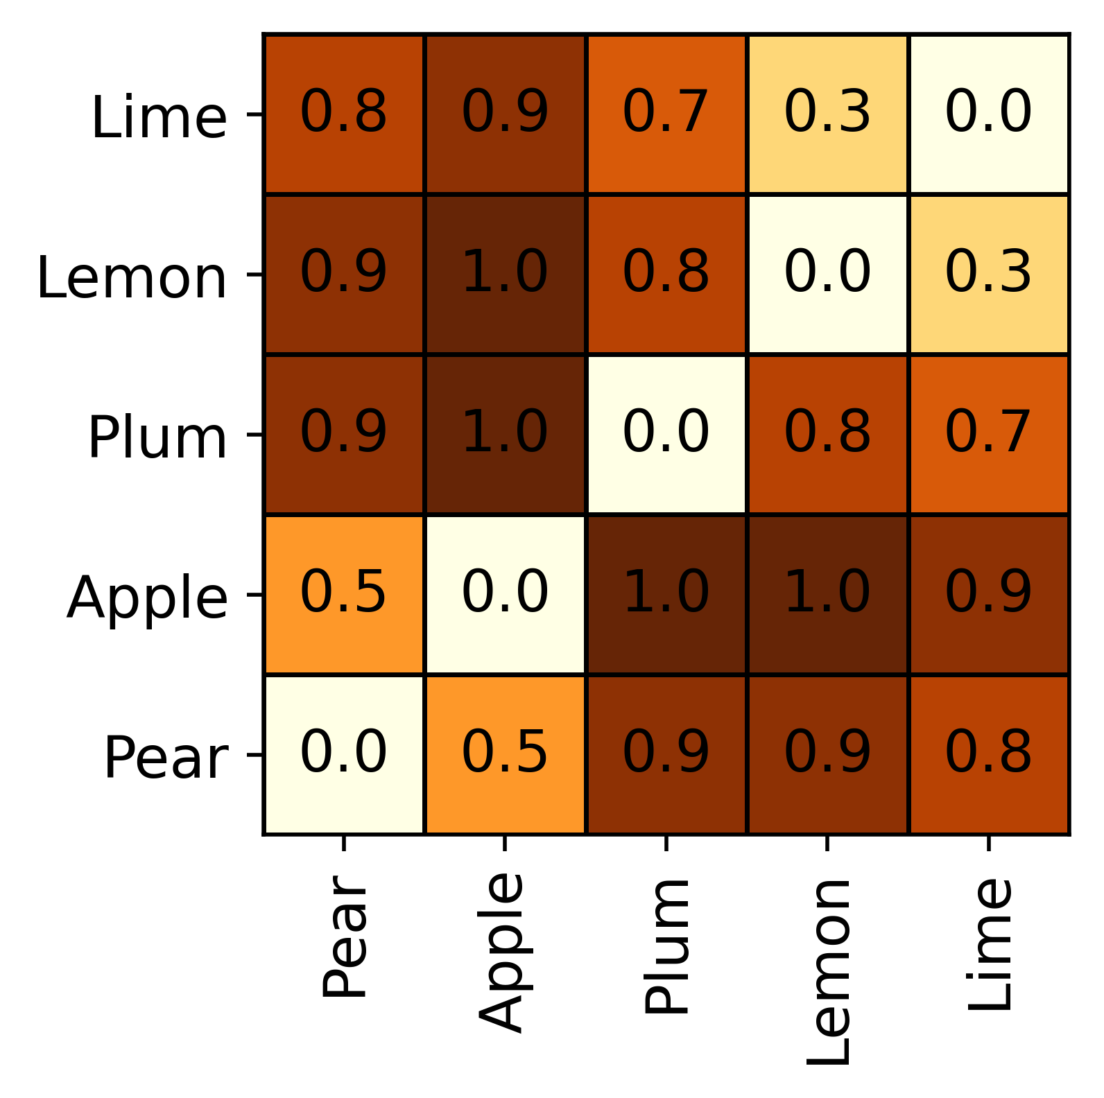
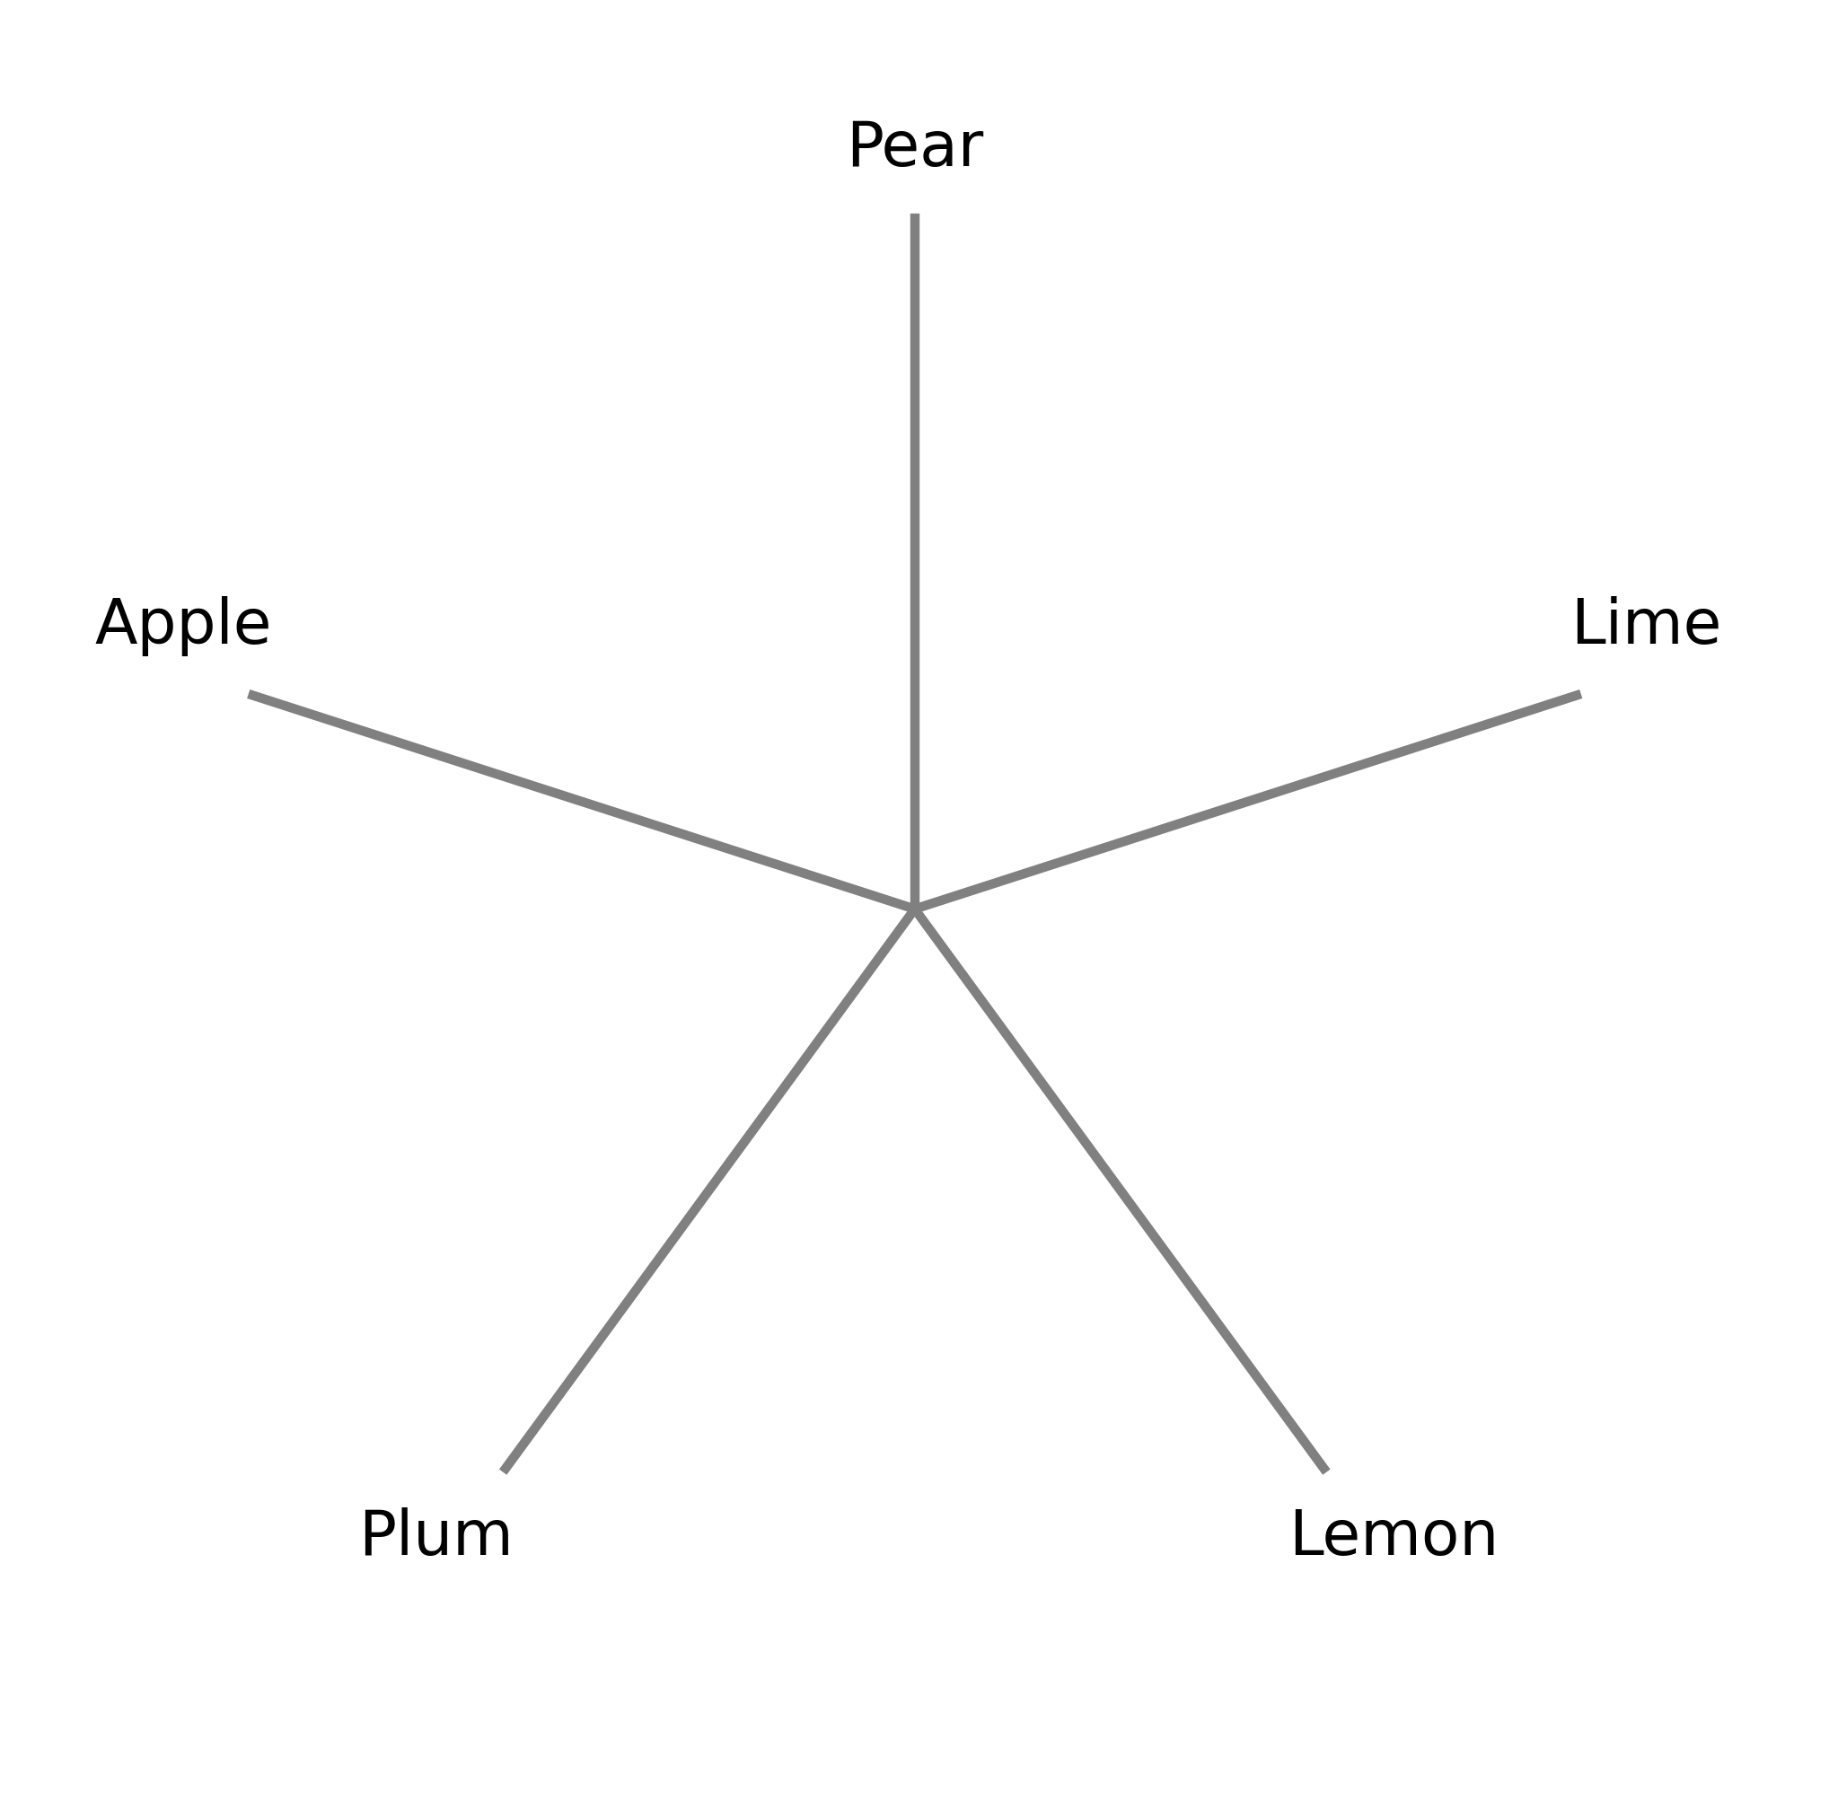
Neighbour Joining (2)
Start with a distance matrix and a star-shaped phylogeny
Note that this matrix is distance rather than similarity – Lemon and Lime are most similar

Slide 40
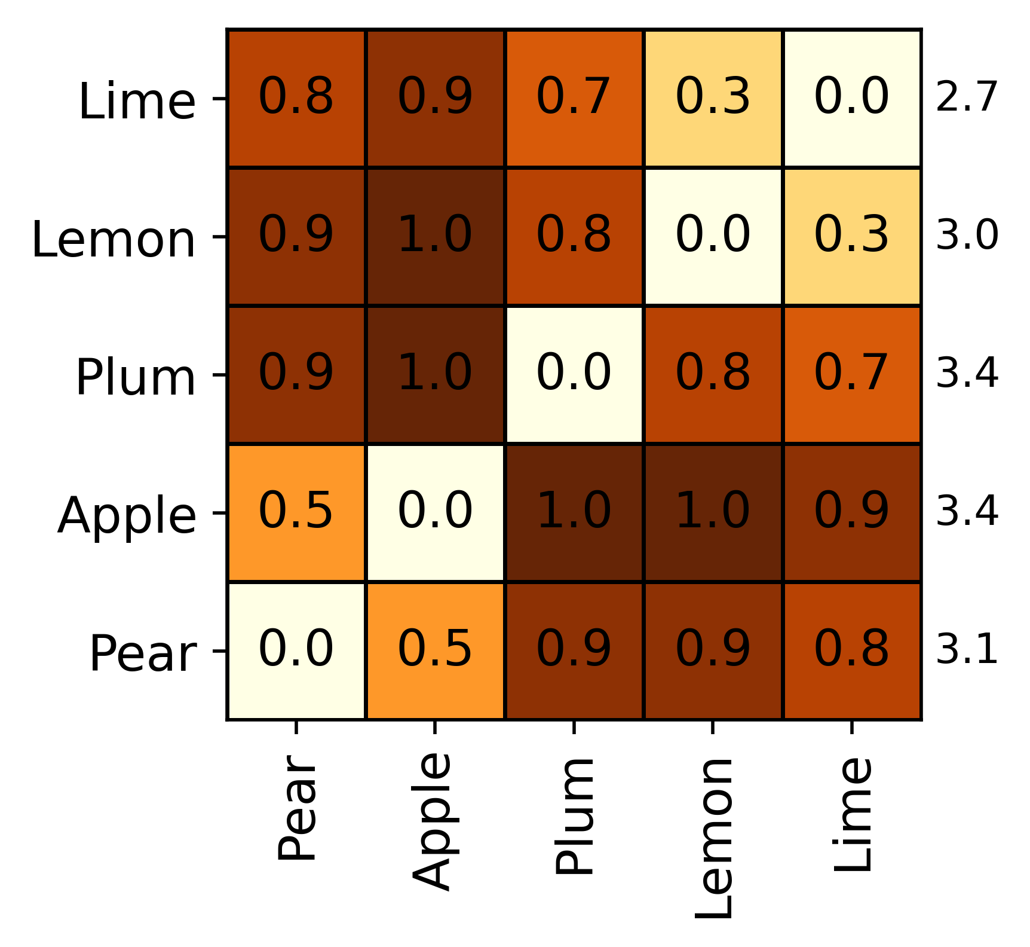
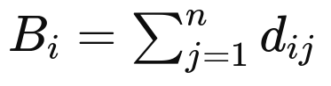
Neighbour Joining (3)
Calculate the total distance between each taxon and all other taxa

Slide 41
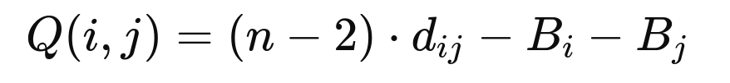
NJ – Q-values (1)
Calculate a matrix of Q-values – this is a measure of the distance between two taxa relative to their distance from all other taxa
n is the number of taxa – currently 5
d_{ij} is the distance between the current taxa = i and j
Bi is the total branch length from i to all other taxa – which we calculated on the previous slide
Bj is the total branch length from j to all other taxa – which we calculated on the previous slide

Slide 42
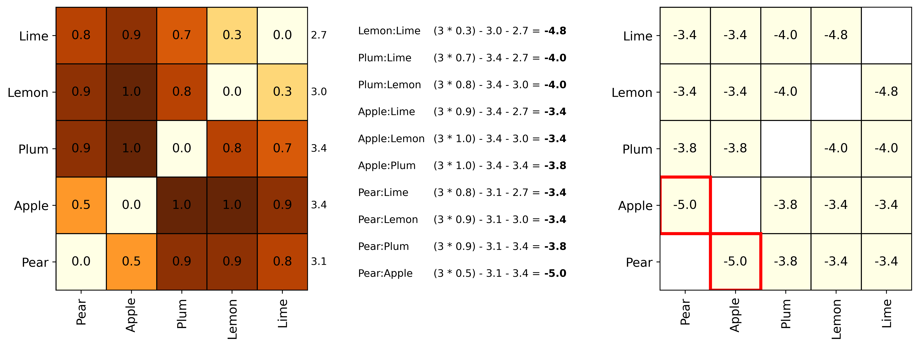
NJ – Q-values (2)
Find the minimum Q-value

Slide 43
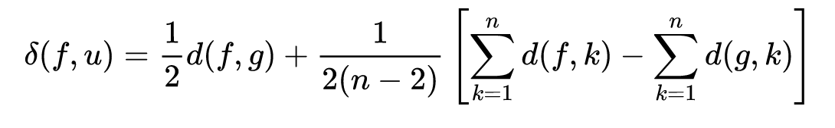
NJ – Branch Lengths (1)
Distribute the branch length between the two species
f = apple
g = pear
u = apple-pear node
Total Branch Length
Apple
Total Branch Length
Pear
Distance between apple and u
½ (0.5) +
((1 / 6) *
(3.4 -
3.1))
0.25 + ((3.4 - 3.1) / 6)
= 0.3
Apple branch = 0.3
Total distance between apple and pear = 0.5
Pear branch = 0.2

Slide 44
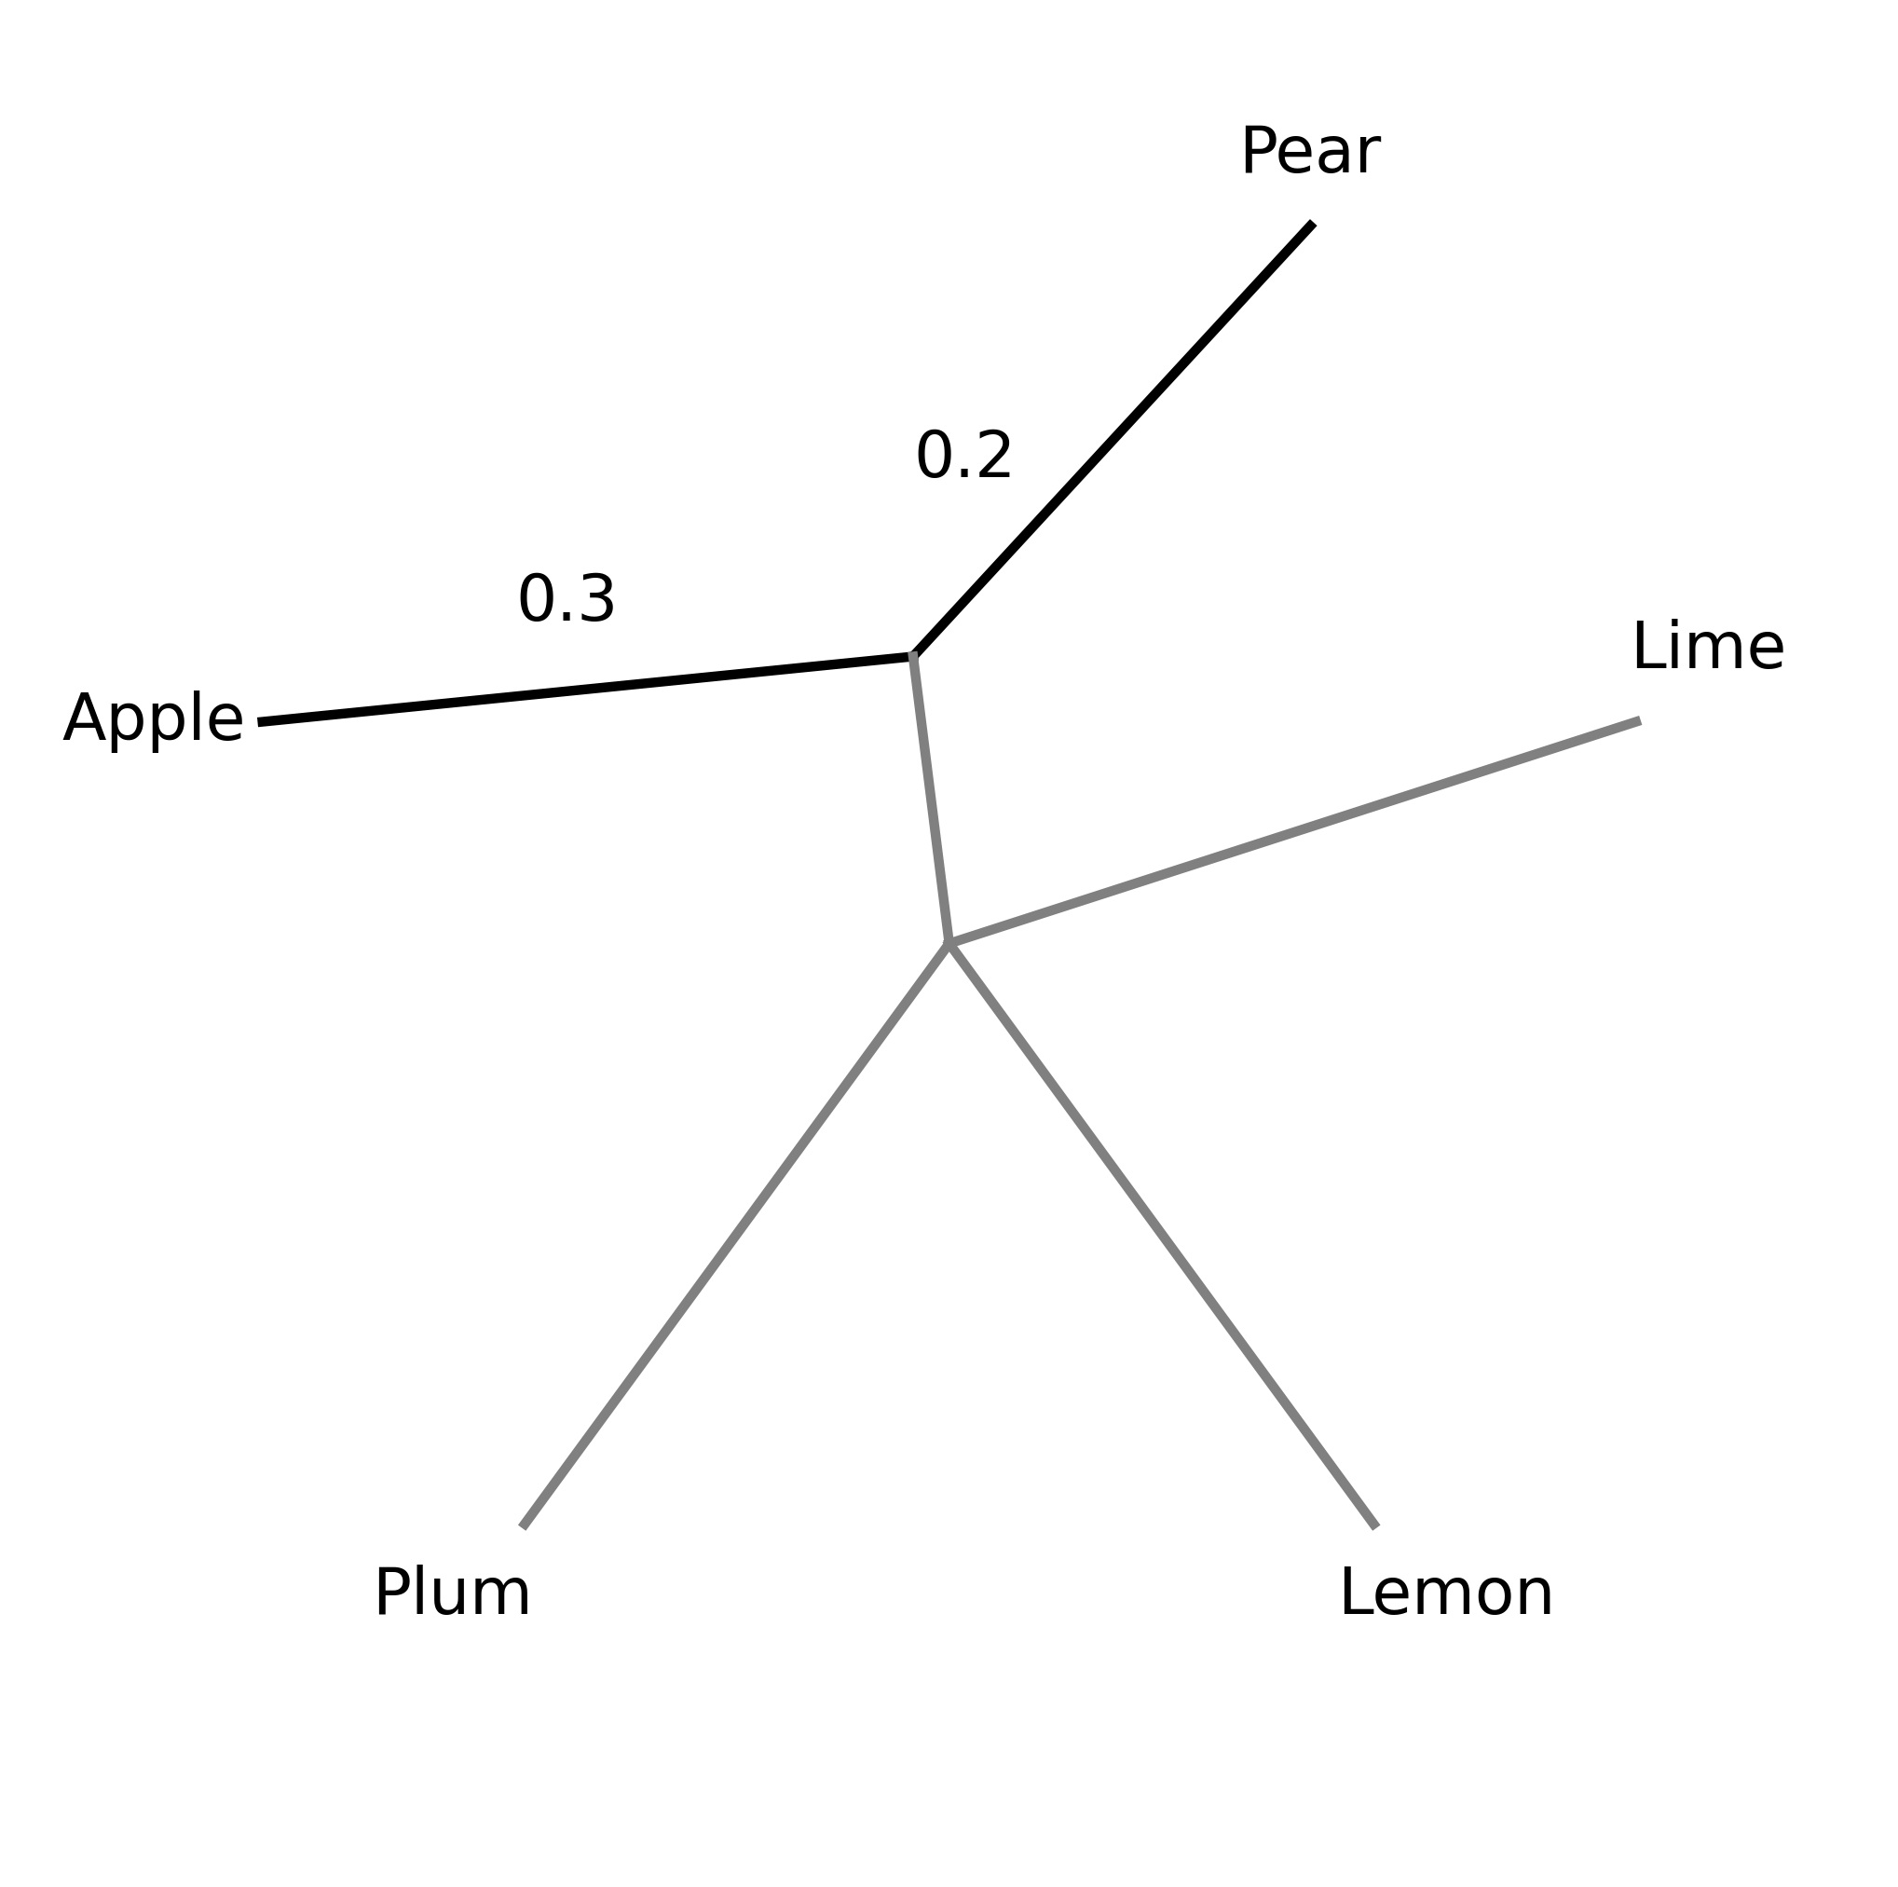
NJ – Join Nodes (1)
Now we can join these two taxa and we know the distance covered by each branch
u

Slide 45
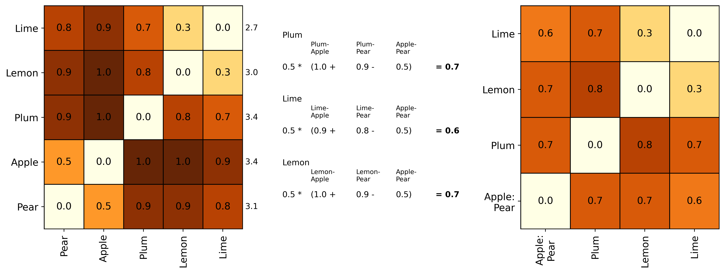
NJ – Join Nodes (2)
Now we recalculate the distance matrix to include the new node

Slide 46
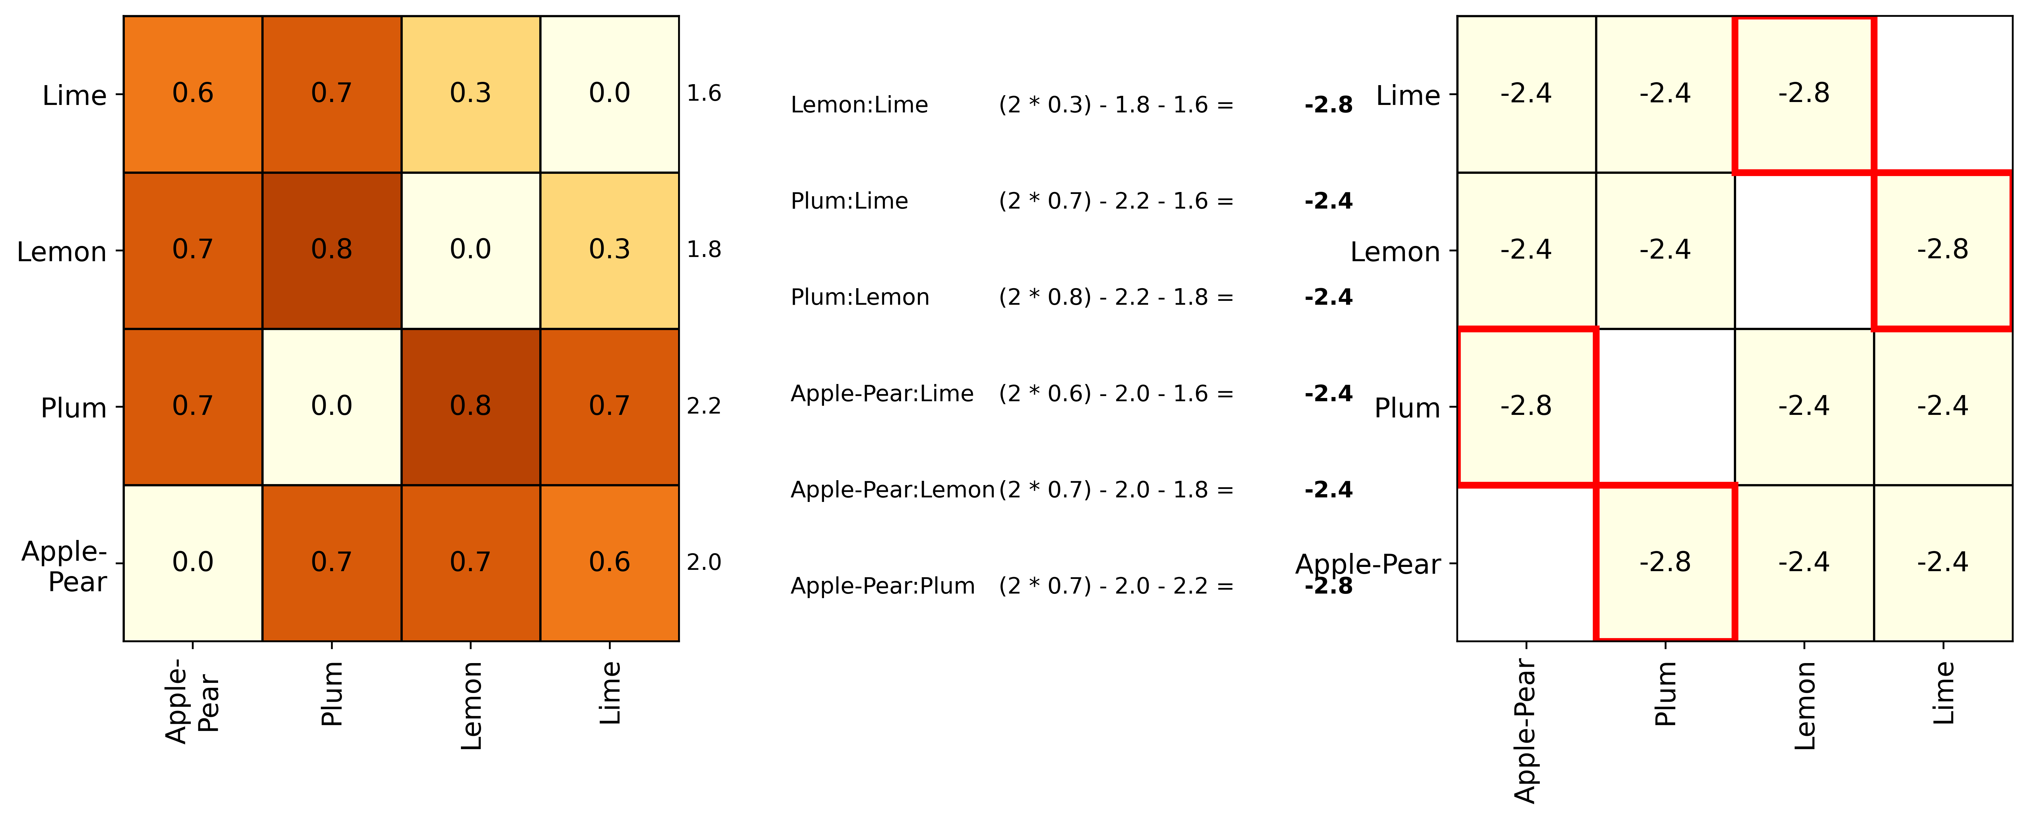
NJ – Recalculate Q-matrix
A new Q-value matrix is calculated including the new node

Slide 47
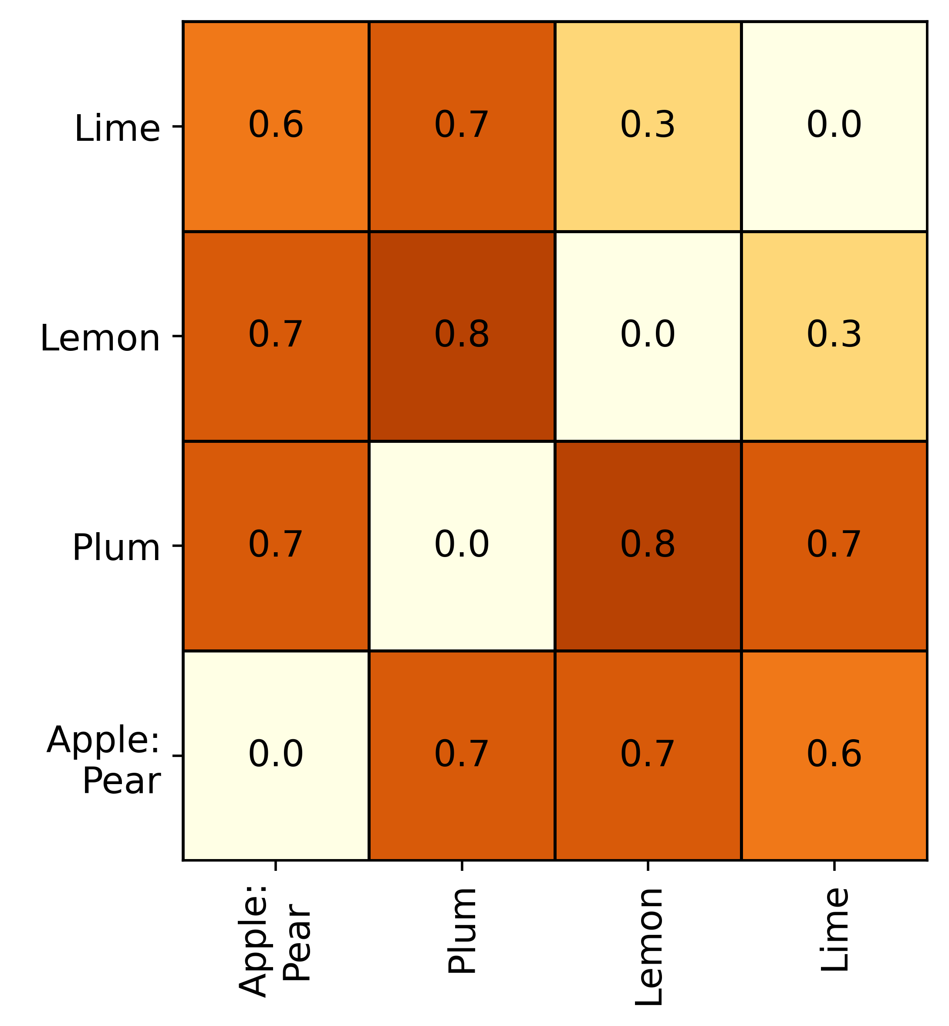
NJ – Branch Lengths (2)
We can join either Lemon-Lime or Apple-Pear-Plum – let's join Lemon and Lime
f = lemon
g = lime
u = lemon-lime node
Total Branch Length
Lemon
Total Branch Length
Lime
½ (0.3) +
((1 / 4) *
(1.8 -
1.6))
0.15 + ((0.2) / 4)
= 0.2
Lemon branch = 0.2
Total distance between lemon and lime = 0.3
Lime branch = 0.1

Slide 48
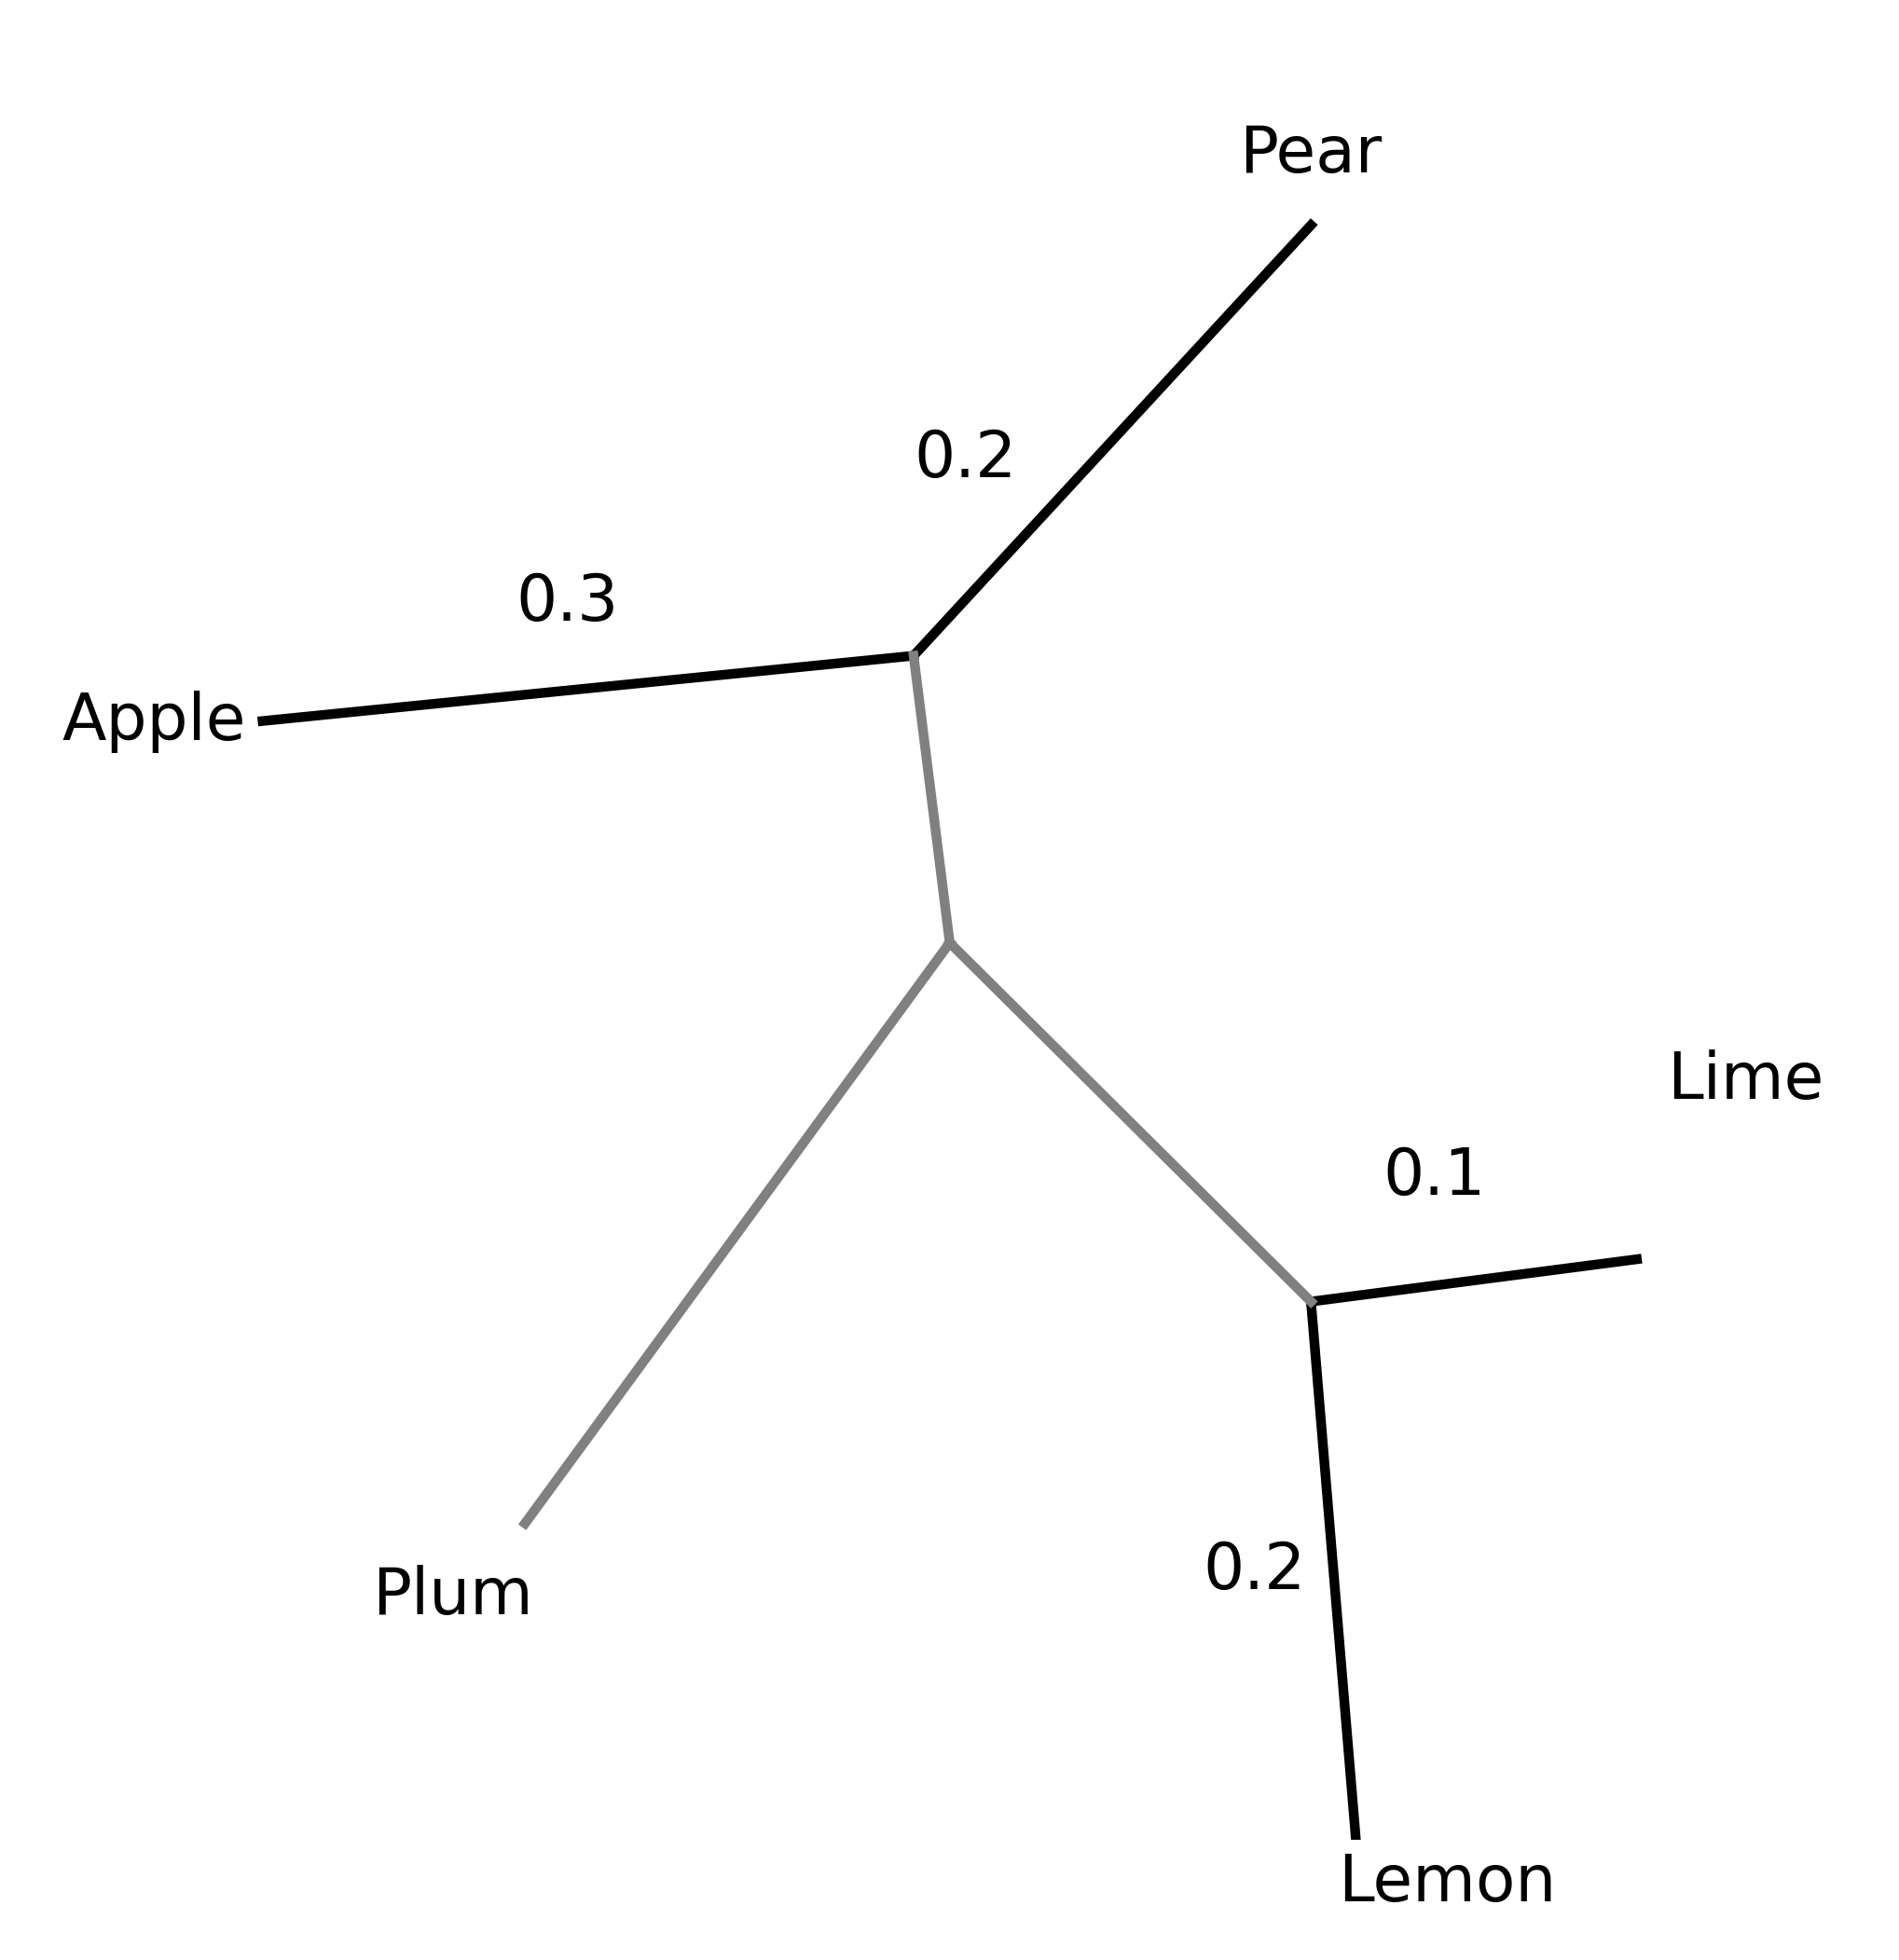
NJ – Join Nodes (3)
We can add this node to the tree, along with the relative branch lengths

Slide 49
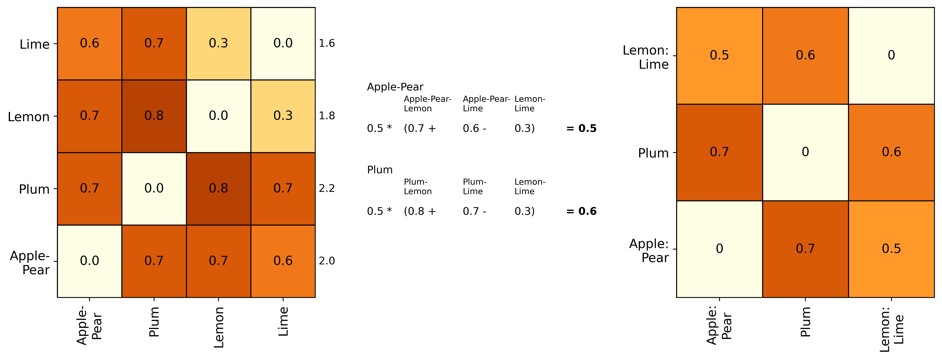
Neighbour Joining (4)
Update the distance matrix

Slide 50
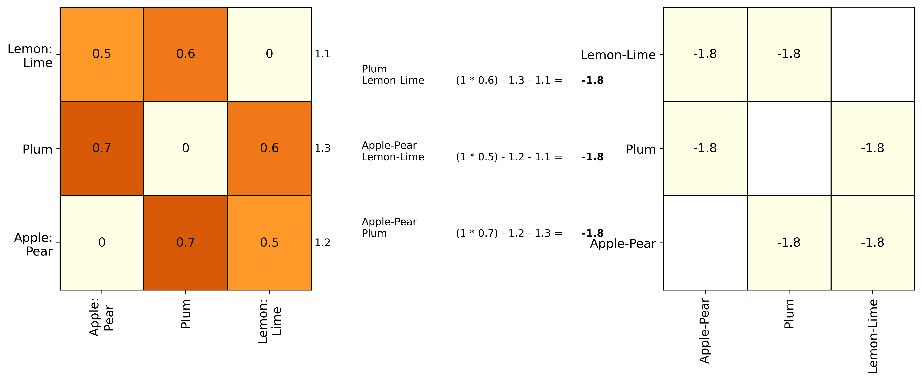
Neighbour Joining (5)
Update the Q-matrix

Slide 51
Neighbour Joining (6)
f = plum
g = apple-pear
u = apple-pear-plum node
Total Branch Length
Plum
Total Branch Length
Apple-Pear
½ (0.7) +
((1 / 2) *
(1.3 -
1.2))
0.35 + ((0.1) / 2)
= 0.4
Plum branch = 0.4
Total distance between apple-pear and plum = 0.7
Apple-pear to plum branch = 0.3

Slide 52
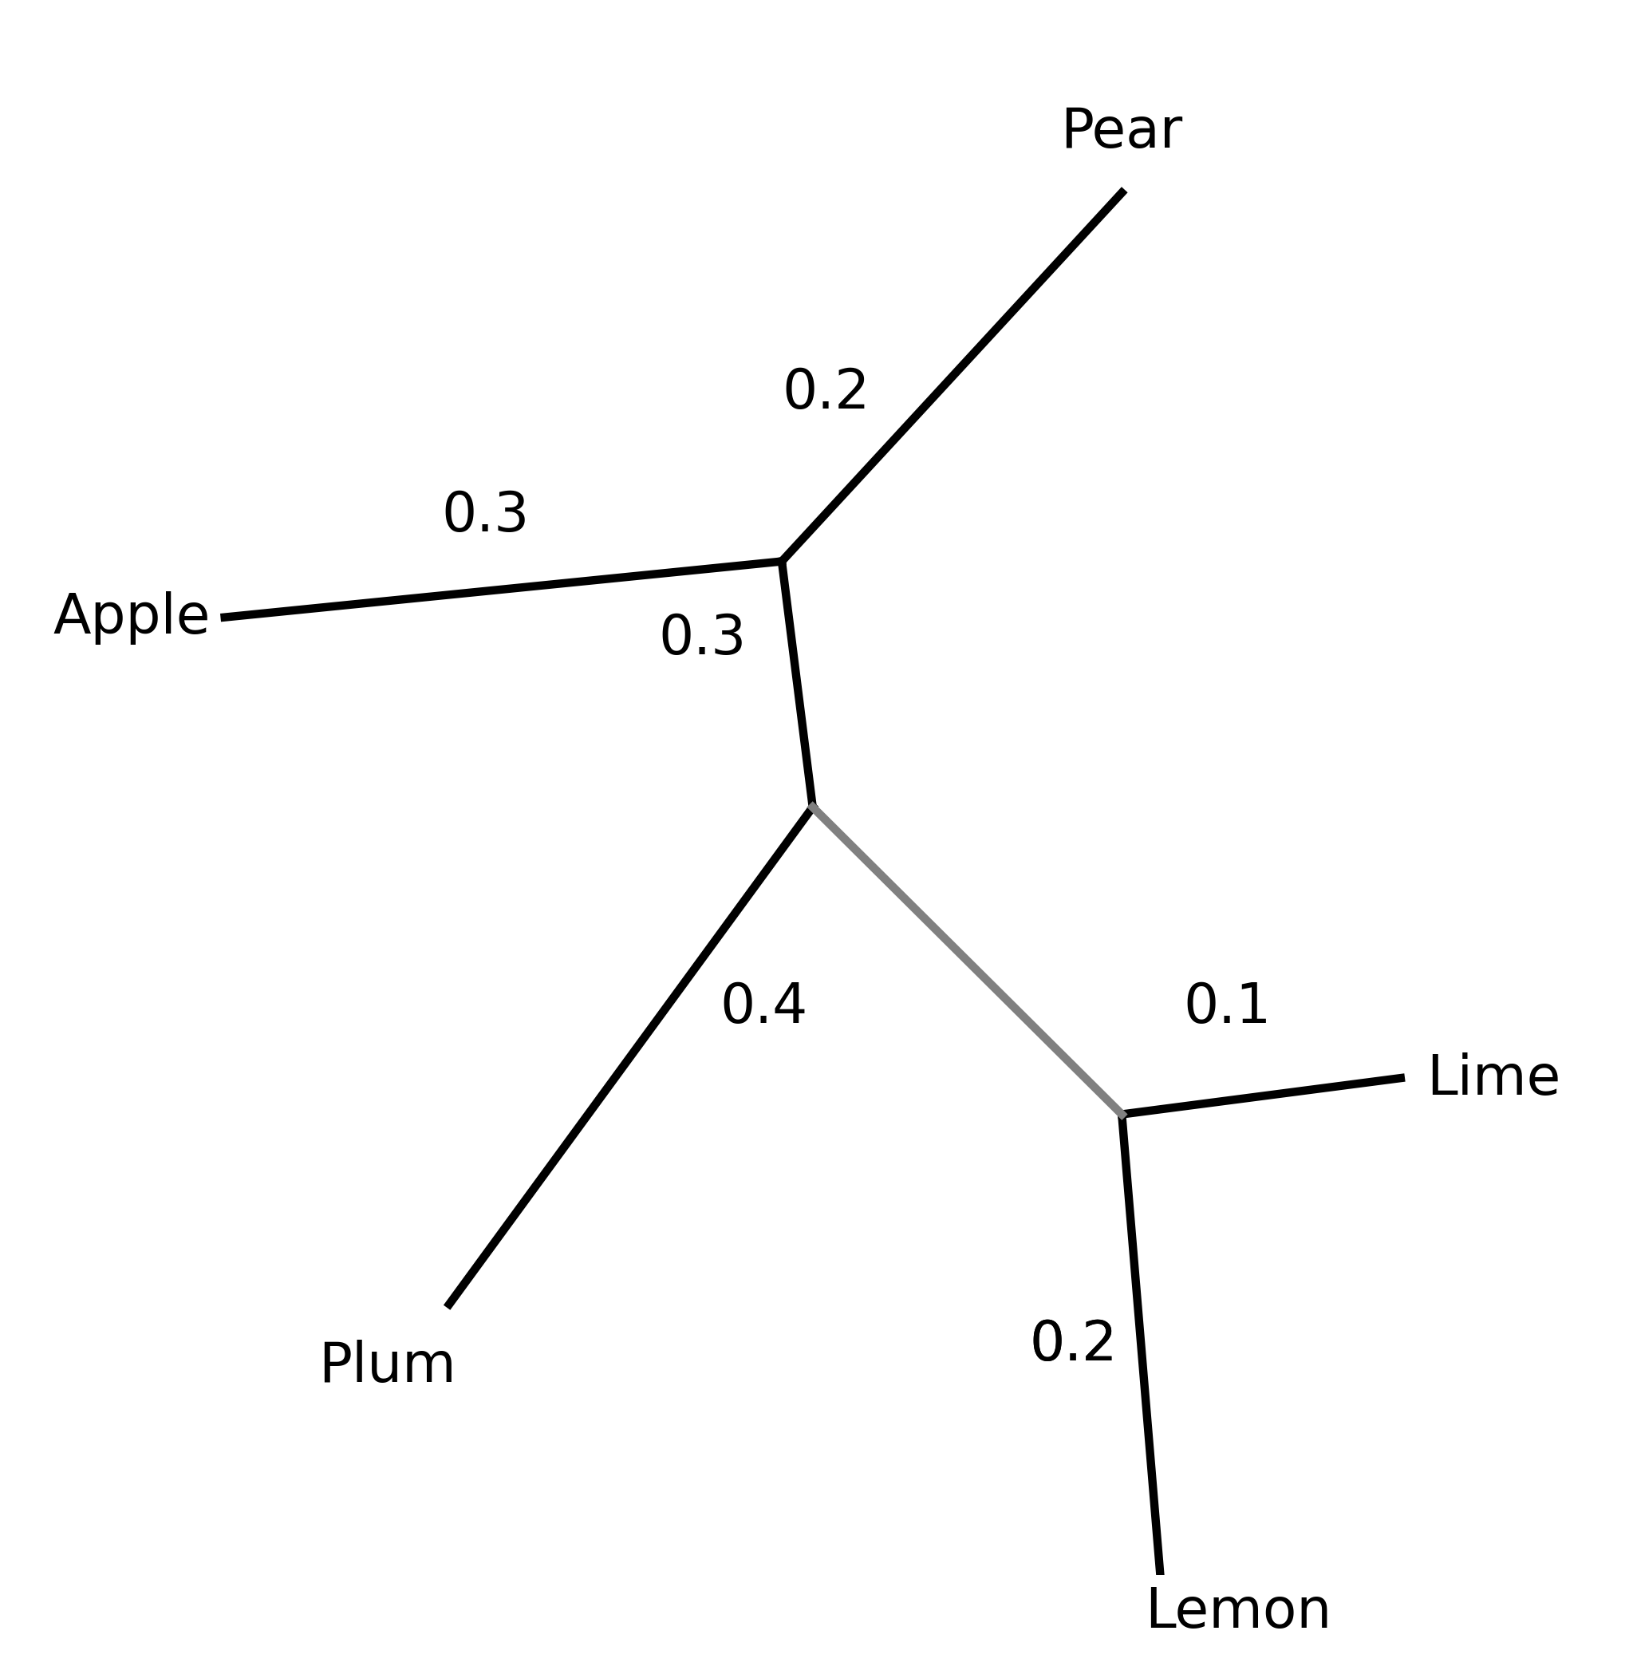

Neighbour Joining (7)
The tree is now complete – we can infer the last branch length based on the others
e.g.
Total distance from Lime to Pear = 0.8
Pear to Apple-Pear Node = 0.2
Apple-Pear Node to Apple-Pear-Plum Node = 0.3
Lemon-Lime Node to Lime node = 0.1
0.8 - 0.3 - 0.2 - 0.1 = 0.2
0.8
0.2

Slide 53


Neighbour Joining (8)
Now we have a fully resolved tree
​
​

Slide 54
Neighbour Joining
This method offers advantages over UPGMA in that relative branch lengths can be calculated
However, it shares these disadvantages with UPGMA:
Doesn't provide any measure of statistical support
Can't explicitly provide an evolutionary model
Doesn't allow for repeated substitutions at the same site
Assumes the distance matrix is indicative of evolutionary distance
Assumes branch lengths are additive
​
​

Slide 55

Maximum Parsimony (1)
Minimises the number of steps required to explain a set of data.
Most parsimonious tree is the tree with the least changes required
Start with every possible tree

Slide 56
Maximum Parsimony
There are many possible trees
Leaves | Unrooted Trees | Rooted Trees
3 | 1 | 3
4 | 3 | 15
5 | 15 | 105
6 | 105 | 945
7 | 945 | 10,395
8 | 10,395 | 135,135
9 | 135,135 | 2,027,025
10 | 2,027,025 | 34,359,425

Slide 57

Maximum Parsimony (2)
For each tree, a possible ancestor of each node is inferred

Slide 58

Maximum Parsimony (3)
The number of changes required to generate the tree, given these ancestors is then counted
Total: 7 changes

Slide 59

Maximum Parsimony (4)
This is repeated for all possible ancestors
Total: 6 changes

Slide 60
Maximum Parsimony (5)
The set of ancestors with the least changes is selected
The parsimony for this tree is the number of changes required to generate the final topology given the ancestors
Total: 6 changes

Slide 61
Maximum Parsimony (7)
This is repeated for every possible tree
The most parsimonious tree is the tree with the least changes
There are many possible trees
Leaves | Unrooted Trees | Rooted Trees
3 | 1 | 3
4 | 3 | 15
5 | 15 | 105
6 | 105 | 945
7 | 945 | 10,395
8 | 10,395 | 135,135
9 | 135,135 | 2,027,025
10 | 2,027,025 | 34,359,425

Slide 62
Maximum Parsimony (8)
Intuitive approach but:
Computationally very intense
Assumes every change is equally likely
Assumes maximum one change per site

Slide 63
Maximum Likelihood (1)
Finds the most likely tree given the data
Uses probability rather than just counting evolutionary events.
Likelihood of a tree is calculated using the sum of the probabilities of the branches of the tree.
Incorporates an evolutionary model

Slide 64
Maximum Likelihood
Maximise the probability of the data given the tree, across all possible trees
Need to optimise:
Tree topology
Branch lengths
Rates of evolution
This can be very computationally demanding

Slide 65

Maximum Likelihood
Uses heuristic approach such as a hill-climbing algorithm to find approximately the best topology
Start with a randomly selected initial tree topology
Calculate the likelihood of the data given this tree
Make small changes to explore neighbouring topologies
Select the optimum amongst the local trees – the local optimum
Repeat steps 2 to 4 until a stopping criterion is met e.g. number of iterations
Can get stuck in local optima, sometimes jumps or random res​tarts are added to reduce this.
Second heuristic approach is needed to optimise the branch lengths

Slide 66


Bayesian Methods
Bayesian approaches are another option to estimate tree topology.
Based on Bayes theorem
Uses likelihood combined with prior probabilities to calculate the probability of the trees given the data – the posterior probability of the tree.
Searches plausible trees to maximise likelihood.
Can incorporate prior probabilities – existing information about what is known and what is plausible
Uses an explicit evolutionary model

Slide 67

Markov Chain Monte Carlo (MCMC) (1)
Bayesian phylogenetic software uses MCMCs to explore the space of possible phylogenetic trees
Markov chain – the probability of transitioning to a future state depends only on the current state and not on the events that preceded it
E.g. board games where moves depend on rolling a dice
Outcome depends on:
Current position
Dice roll

Slide 68
Markov Chain Monte Carlo (MCMC) (2)
Monte carlo – uses random sampling to approximate mathematical distributions
MCMC – Monte carlo sampling is used to generate a series of parameter values by iteratively sampling from a distribution
Each new set of values is accepted or rejected depending on the if the probability of the data given the current tree is more or less.

Slide 69
Bayesian Methods
Can incorporate lots of information but computationally expensive
Runs two chains and runs until convergence – until the two chains are the same as each other (or similar above a threshold).

Slide 70
Summary
A phylogenetic tree is the outcome of a phylogenetic analysis – an analysis of the evolutionary relationships among or within a group of organisms
It is a hypothesis, based on the data and methodology
Various features of trees are important to recognise
Trees can be rooted or unrooted
Trees can be build using a distance-based, parsimony, likelihood or Bayesian approach

